Slide 1

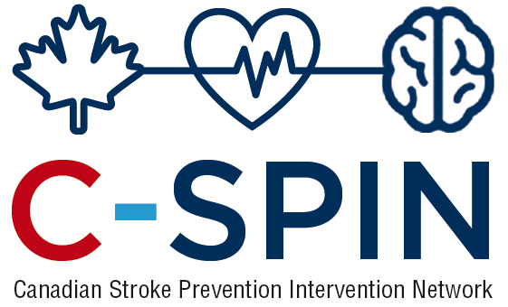


Atrial Fibrillation: New Insights
Sub-clinical AF and its management
Jeff Healey MD, MSc, FRCP, FHRS
PHRI Chair in Cardiology Research
Population Health Research Institute
McMaster University, Canada

Slide 2
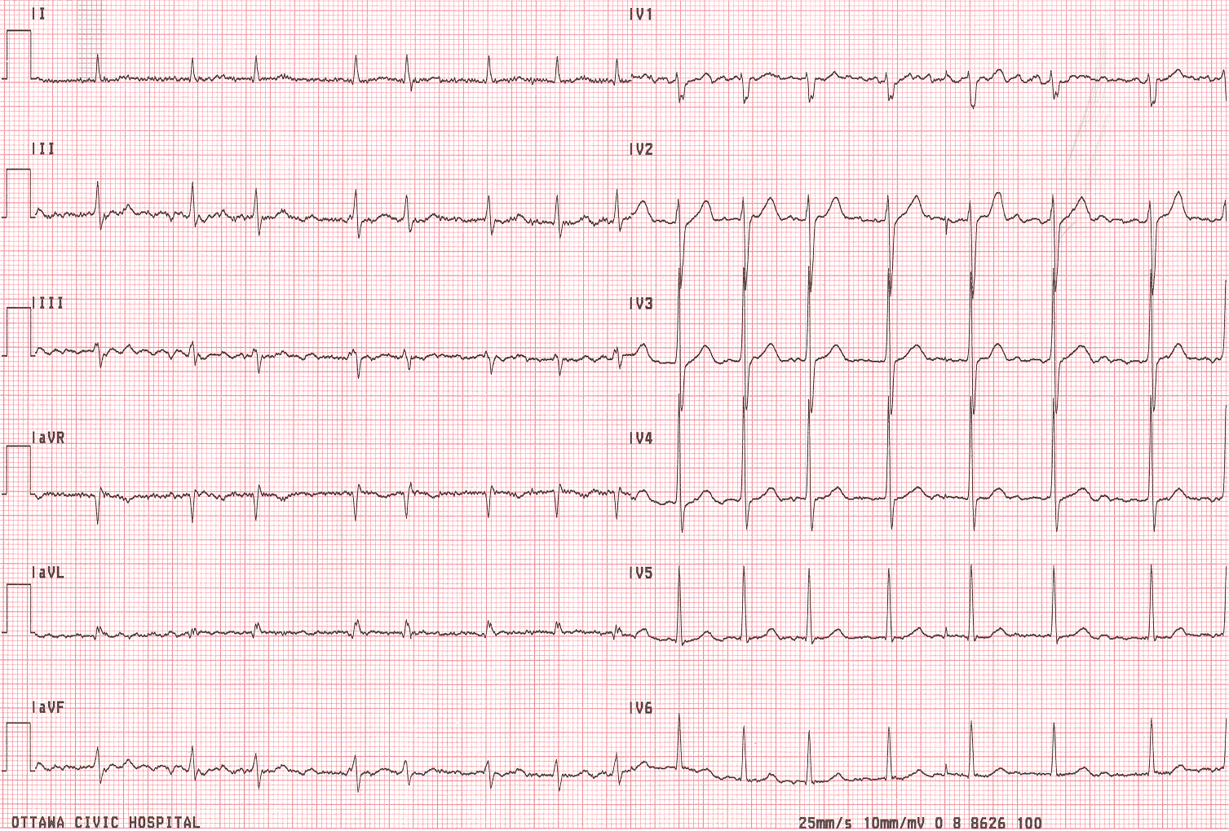
What is Atrial Fibrillation?
Cohort studies such as Framingham performed 12-lead ECG 1-2/year
70-80% of patients in RCTs of anticoagulation had persistent or permanent AF (those with paroxysmal had to have high burden)

Slide 3
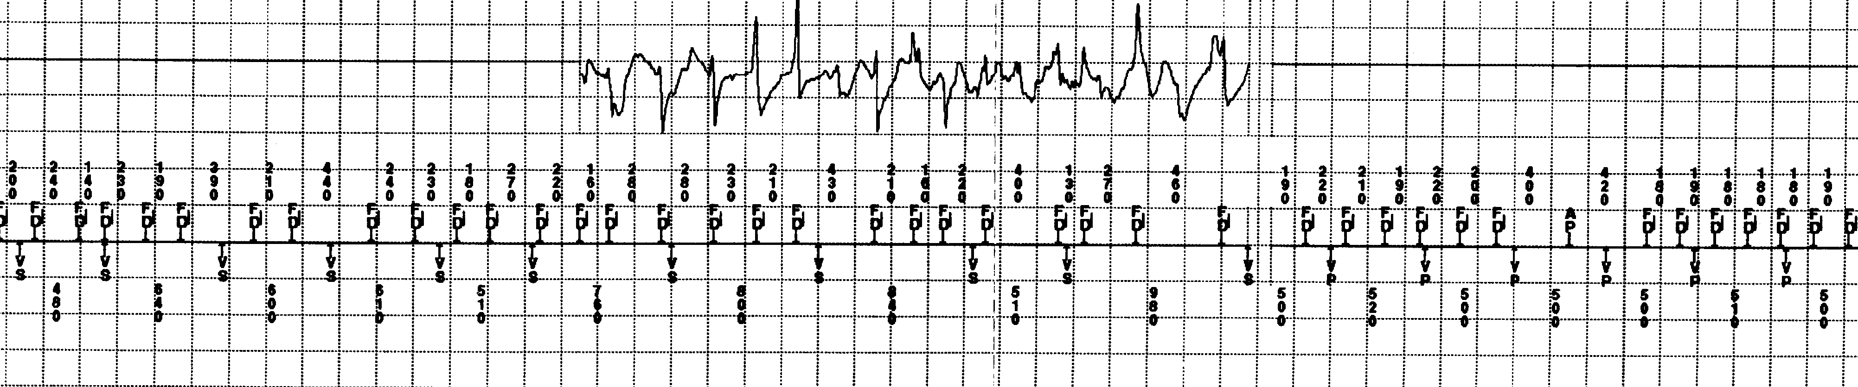
Sub-Clinical AF Detected by Pacemakers
Mostly asymptomatic
Relatively short episodes detected only
with long-term, continuous monitoring

Slide 4
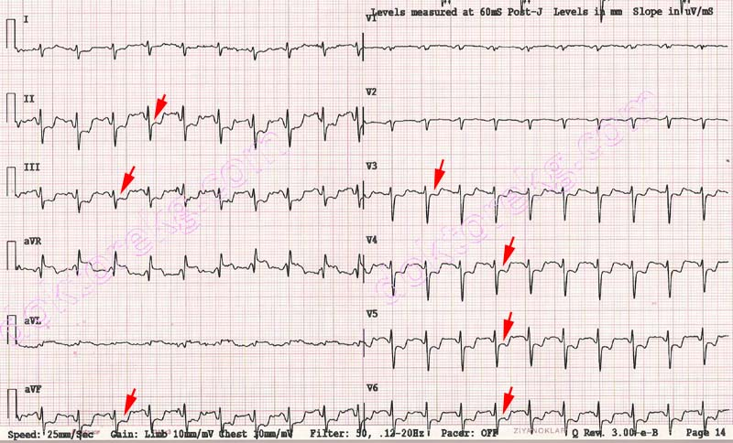
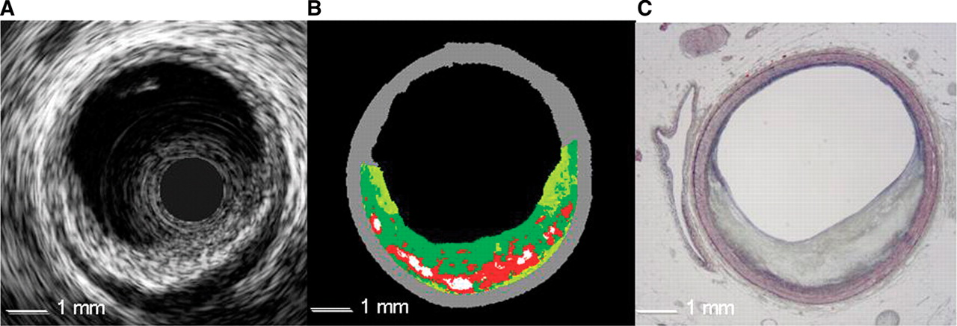
Importance of Sampling Method

Slide 5
ASSERT, NEJM 2012
Atrial Tachyarrhythmia > 6 min, >190 bpm
ASSERT : Time to Adjudicated AHRE(>6 minutes,>190/minute)
# at Risk
Year 0.5
1.0
1.5
2.0
2.5
3.0
3.5
4.0
0.6
2580
2059
1842
1663
1371
1008
706
446
243
0.5
0.4
Cumulative Hazard Rates
0.3
3 month
Visit
0.2
0.1
0.0
0
0.5
1.0
1.5
2.0
2.5
3.0
3.5
4.0
Years of Follow-up

Slide 6
ASSERT: Clinical Outcomes
Healey JS, NEJM 2012
Event | Device-Detected Atrial Tachyarrhythmia |  |  |  | Device-Detected Atrial Tachyarrhythmia Present vs. absent
 | Absent N=2319 |  | Present N= 261
 | events | %/year | events | %/ year | RR | 95% CI | p
Ischemic Stroke or Systemic Embolism | 40 | 0.69 | 11 | 1.69 | 2.49 | 1.28 – 4.85 | 0.007
Vascular Death | 153 | 2.62 | 19 | 2.92 | 1.11 | 0.69 – 1.79 | 0.67
Stroke / MI / Vascular Death | 206 | 3.53 | 29 | 4.45 | 1.25 | 0.85 – 1.84 | 0.27
Clinical Atrial Fibrillation or Flutter | 71 | 1.22 | 41 | 6.29 | 5.56 | 3.78 – 8.17 | <0.001

Slide 7
Clinical Outcomes by CHADS₂
Healey JS, NEJM 2012
CHADS₂ Score | Total Pts. | Sub-clinical Atrial Tachyarrhythmia between enrollment and 3 months |  |  |  |  |  | Sub-clinical Atrial Tachyarrhythmia Present vs. absent
 |  | Present |  |  | Absent
 |  | Pts. | events | %/year | Pts. | events | %/year | HR | 95% CI | P trend
1 | 600 | 68 | 1 | 0.56 | 532 | 4 | 0.28 | 2.11 | 0.23 – 18.9 | 0.35
2 | 1129 | 119 | 4 | 1.29 | 1010 | 22 | 0.77 | 1.83 | 0.62 – 5.40
>2 | 848 | 72 | 6 | 3.78 | 776 | 18 | 0.97 | 3.93 | 1.55 – 9.95

Slide 8
Risk of Stroke/SE According to Duration of SCAF
0.20
No SCAF
6mins~6hrs
6hrs~24hrs
0.15
>24hrs
Cumulative event rates
0.10
0.05
0.0
0
0.5
1
1.5
2
2.5
3
3.5
No. at Risk
Years of Follow-up
No SCAF
2455
1926
1708
1528
1251
900
624
390
6mins~6hrs
0
226
302
347
322
281
218
155
6hrs~24hrs
0
88
104
103
108
93
80
52
>24hrs
0
91
124
144
140
126
116
85
ASSERT; van Gelder IC, Eur Heart J 2017

Slide 9
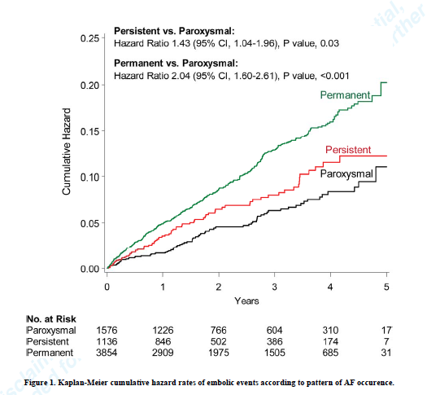
ACTIVE-AVERROES
N=6563, ASA-treated
Venassche T. Eur Heart J. 2014

Slide 10
Atrial Fibrillation and Stroke
Relative risk for ischemic stroke appears increased for all types of AF and SCAF
Appears to be a stepwise increase in ABSOLUTE risk with greater AF burden
Further insights may come from large administrative datasets linking pacemaker or cardiac monitoring data with stroke

Slide 11


Is Sub-clinical AF different?

Slide 12
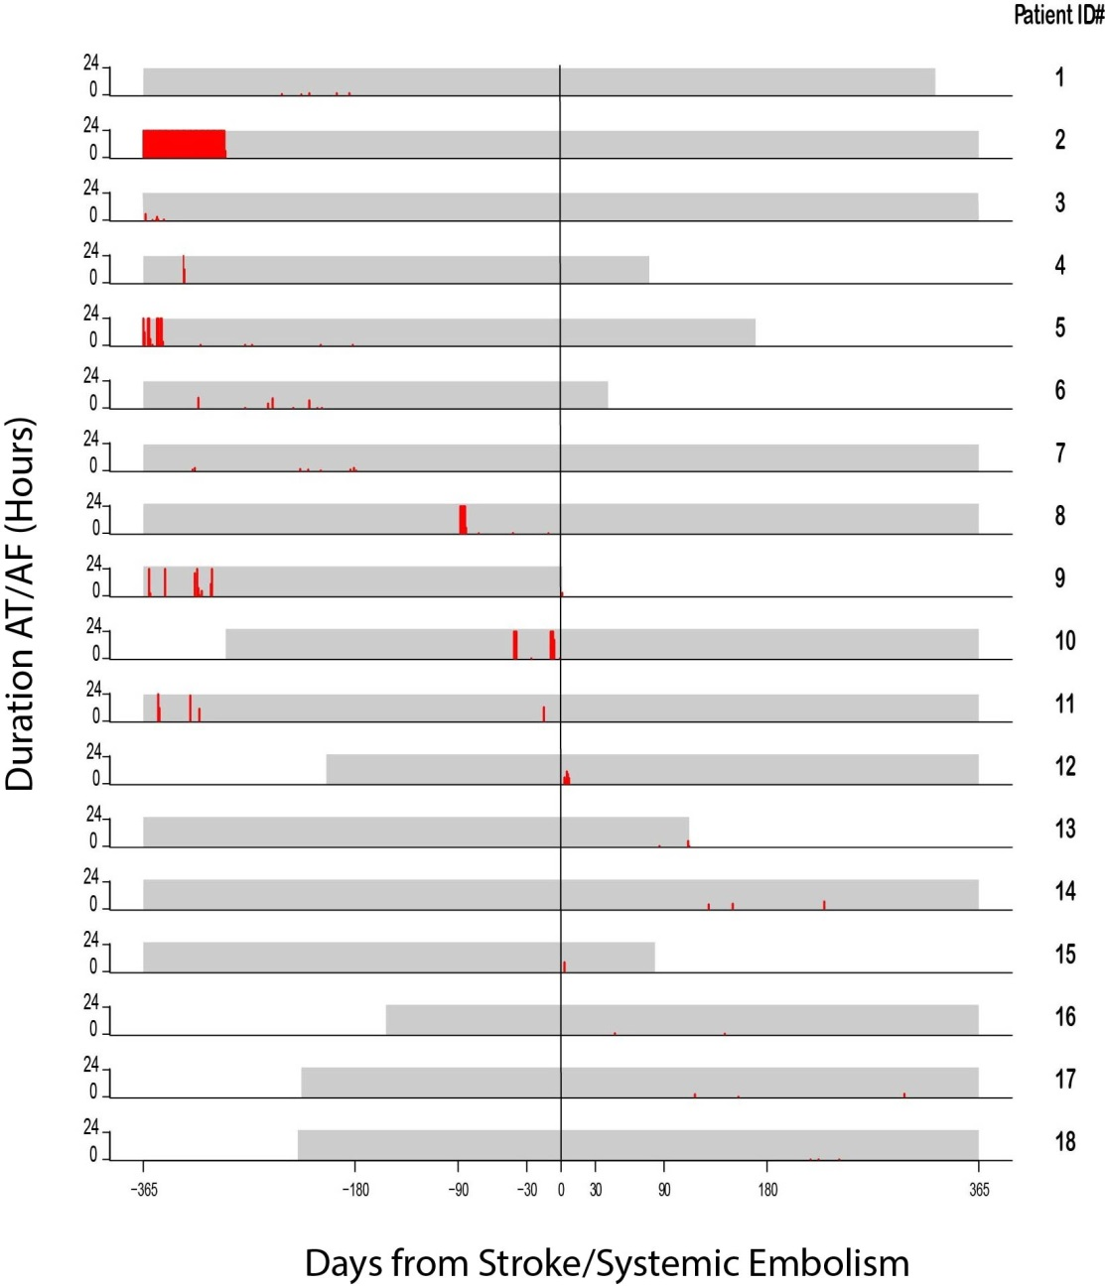
Relation between AF and Stroke
M. Brambatti
Circulation 2014

Slide 13
SCAF, Stroke Sub-Type and Severity in ASSERT

Slide 14
Stroke in Anticoagulated AF Patients
RE-LY, Connolly SJ, NEJM 2009

Slide 15
Bleeding Complications with OAC
 | Major Bleeding | Fatal Bleeding
ACTIVE-W Warfarin | 2.2%/year | 0.26%/year
RE-LY Warfarin Dabigatran – 150 BID | 3.4%/year 3.1%/year
ROCKET-AF Warfarin Rivaroxaban | 3.4%/year 3.6%/year | 0.5%/year 0.2%/year
….and pacemaker patients are older

Slide 16
Sub-Clinical AF versus AF
Stroke risk is lower (both absolute and relative risks)
Strokes appear less severe
Different mix of stroke sub-types?
Will oral anticoagulation have the same effect?
  Oral anticoagulation (particularly NOACs) are highly effective in clinical trials of patients with clinical AF
  But, oral anticoagulation increases bleeding risk
  Cost-effectiveness of treating lower-risk patients?

Slide 17

IMPACT Study: Anticoagulation Protocol
Intervention Group
Any AT
CHADS₂ 1 & 2
Start OAC
Stop OAC
AT for ≥48h
No AT for 30d
Continuous remote
monitoring for AT
(36 of 48 atrial beats
≥200 bpm)
Any AT
CHADS₂ 3 & 4
Start OAC
Stop OAC
AT for ≥24h in 2d
No AT for 90d
CHADS₂ 5 & 6
(or prior TE)
Start and maintain OAC
Any AT

Slide 18
IMPACT: Clinical Outcomes
 | Control Group N = 1,361 |  |  | Intervention Group N = 1,357 |  | Hazard Ratio | p
 | N | rate |  | N | rate
Primary endpoint | 61 | 2.3 |  | 63 | 2.4 | 1.06 | 0.732
Mortality | 140 | 5.1 |  | 147 | 5.4 | 1.07 | 0.662
Thromboembolism | 37 | 1.4 |  | 32 | 1.2 | 0.88 | 0.586
Ischemic stroke | 28 | 1.0 |  | 22 | 0.8 | 0.79 | 0.417
Systemic embolism | 2 |  |  | 0 |  | - | 0.969
TIA | 8 |  |  | 10 |  | 1.27 | 0.619
Hemorrhagic stroke | 3 | 0.1 |  | 3 | 0.1 | 1.03 | 0.973
Other major bleed | 32 | 1.2 |  | 43 | 1.6 | 1.39 | 0.145
Rates are expressed as the number of events per 100 patient-years.

Slide 19
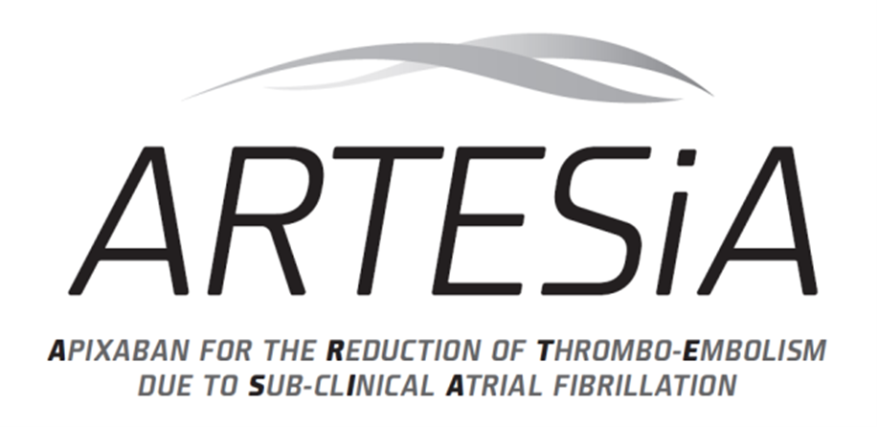
Patients with:
SCAF (at least 1 episode ≥ 6 min but none > 24 hrs)
CHA₂DS₂-VASc score ≥ “3”
CONSENT and RANDOMIZE
* 2.5 mg if either of the following:
At least 2 of 3 of:
  Age ≥ 80
  Weight ≤ 65 kg
  Serum Creatinine ≥ 133 µmol/L (1.5 mg/dL)
Ongoing need for inhibitor of both CYP3A4 and P-glycoprotein
Active aspirin
81mg OD
+
Placebo apixaban bid
Placebo aspirin OD
+
Active apixaban
5mg or 2.5mg* bid
Double-blind,
double-dummy
design
Follow-up Visits at 1 month and every 6 months
until 248 primary efficacy outcomes (est. avg 3 yrs)
Primary Efficacy Outcomes: Primary Safety Outcomes:
Stroke (including TIA with imaging) Major Bleeding (ISTH)
Systemic Embolism

Slide 20
Role of Oral Anticoagulation in SCAF?
Ongoing studies will determine the value of oral anticoagulation for patients with PM or ICD who develop SCAF
  Relative risk reduction
  Absolute risk reduction, risk-benefit ratio, cost-effectiveness
Until then, certain patient groups may warrant empiric therapy with OAC
  SCAF > 24 hours in duration
  Recent cardio-embolic stroke

Slide 21

Sub-Clinical AF: Beyond the Pacemaker Population

Slide 22
Cryptogenic Stroke:
CRYSTAL-AF (N=450)

Slide 23
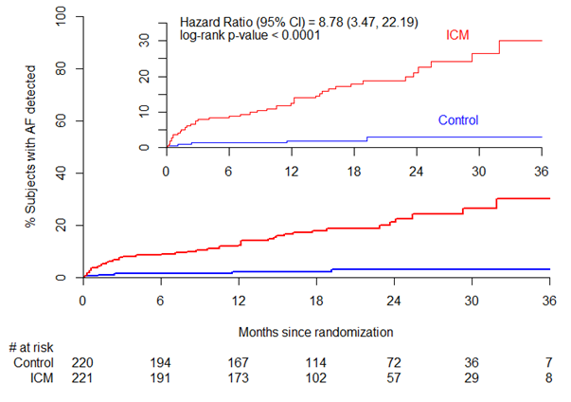
CRYSTAL-AF Trial: AF at 3 years
R. Bernstein 2014
Rate of detection in ICM arm was 30.0% vs 3.0% in control arm
Notes:
Fix the picture

Slide 24
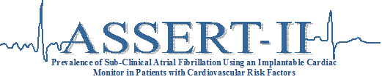
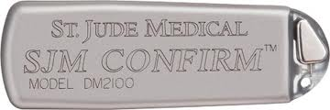
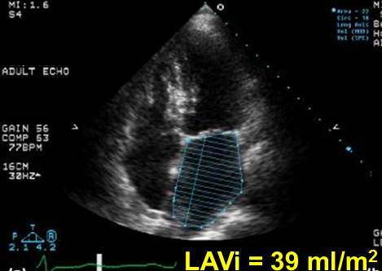
Healey JS
Circulation 2017
Age ≥ 65, attending cardiology/neurology clinic
and
One of :
    -CHA₂DS₂-VASc ≥ 2
    -Obstructive sleep apnea
    -BMI >30
  and
One of :
    -Left atrial volume ≥ 58ml or LA diameter ≥ 4.4cm
    -Serum NT-ProBNP ≥ 290 pg/mL

Slide 25

ASSERT-II: Patient Characteristics (N=256)
Age, mean±SD | 73.85±6.24
Female, n(%) | 88 (34.4)
Caucasian, n(%) | 246 (96.1)
History of Hypertension, n(%) | 188 (73.4)
Heart failure, n(%) | 22 (8.6)
Diabetes, n(%) | 64 (25.0)
Prior stroke, TIA or SE, n(%) | 123 (48.0)
Sleep Apnea, n(%) | 29 (11.3)
BMI | 28.69±4.64
Valvular Heart Disease, n(%) | 37 (14.5)
CHA₂DS₂-VASc, mean±SD | 4.14±1.36
LA diameter (cm), mean±SD | 4.74±0.79
LA volume (ml), mean±SD | 76.53±20.61

Slide 26
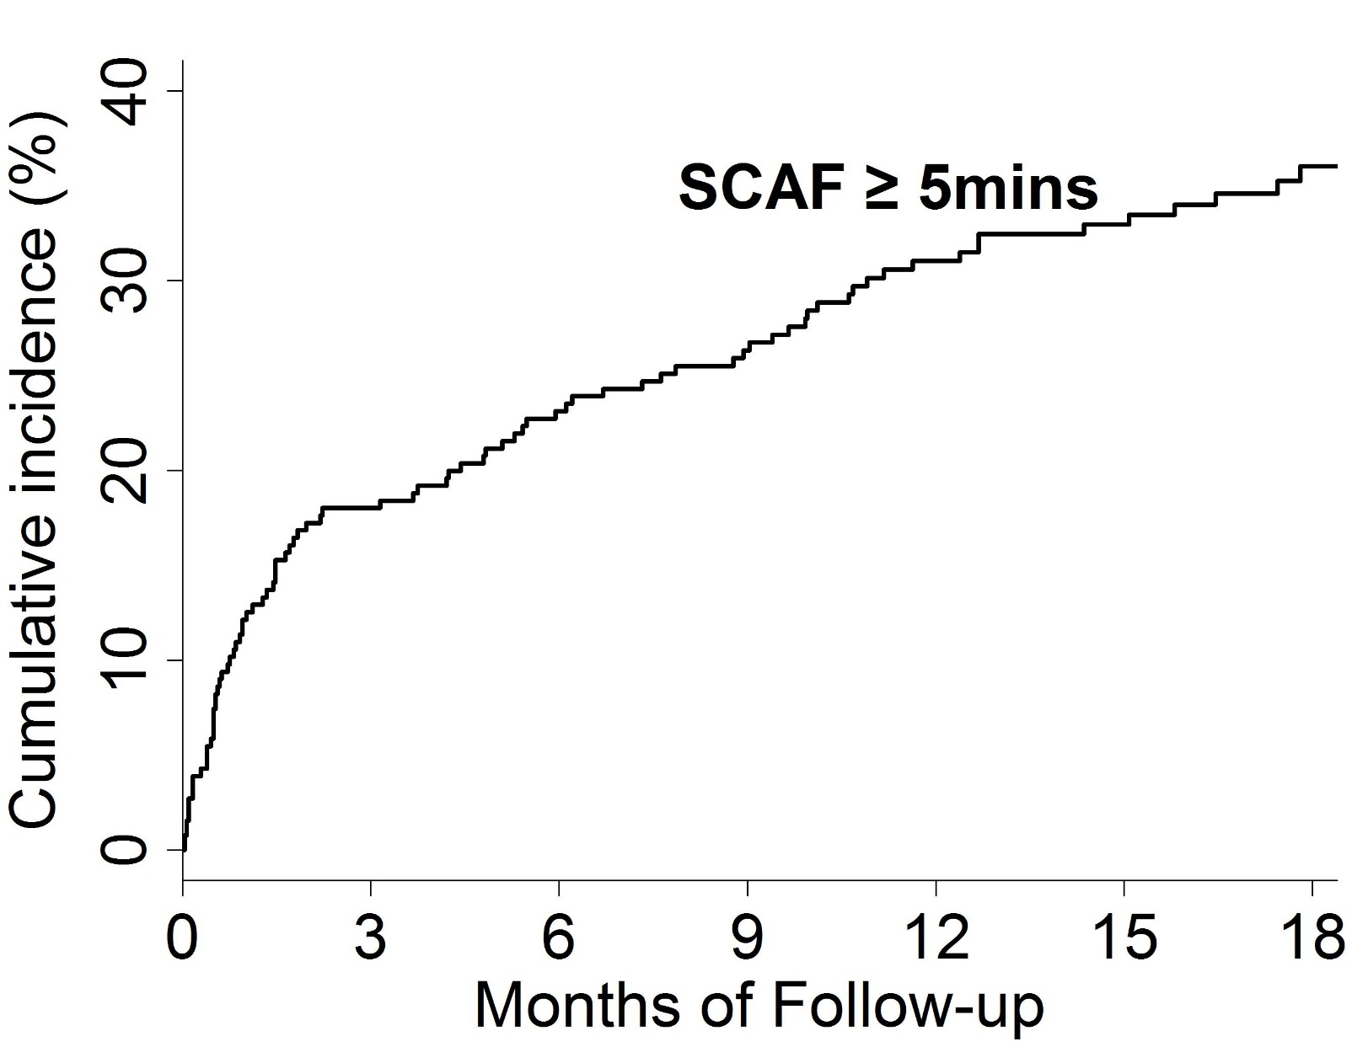
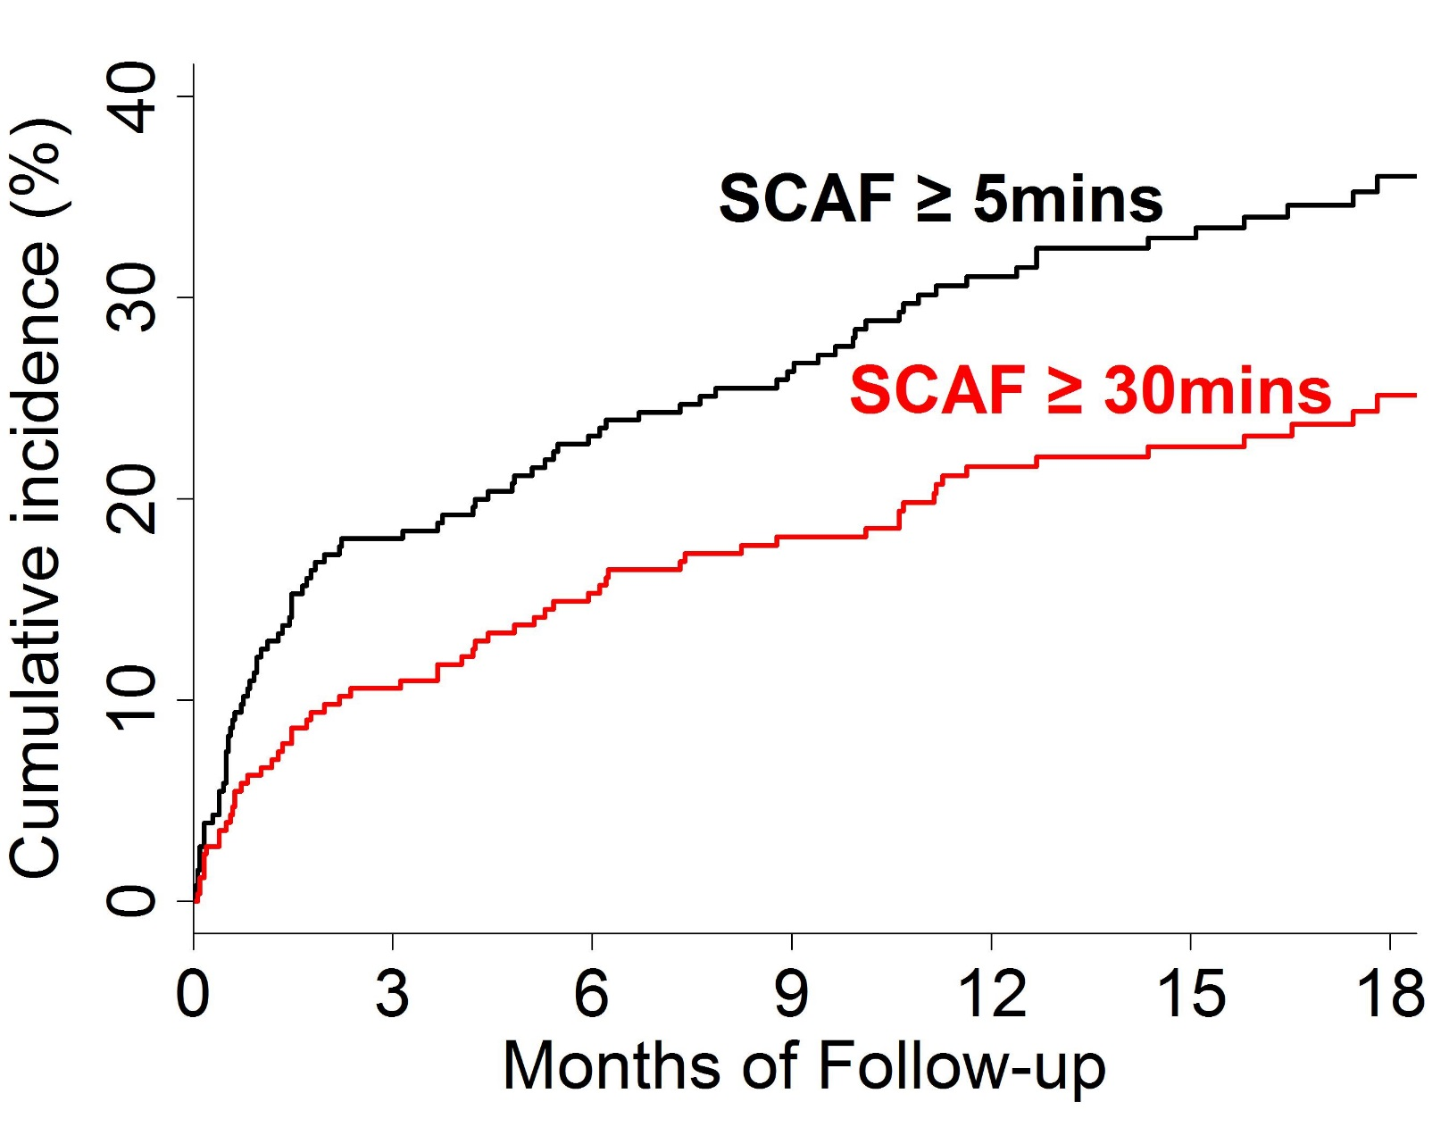
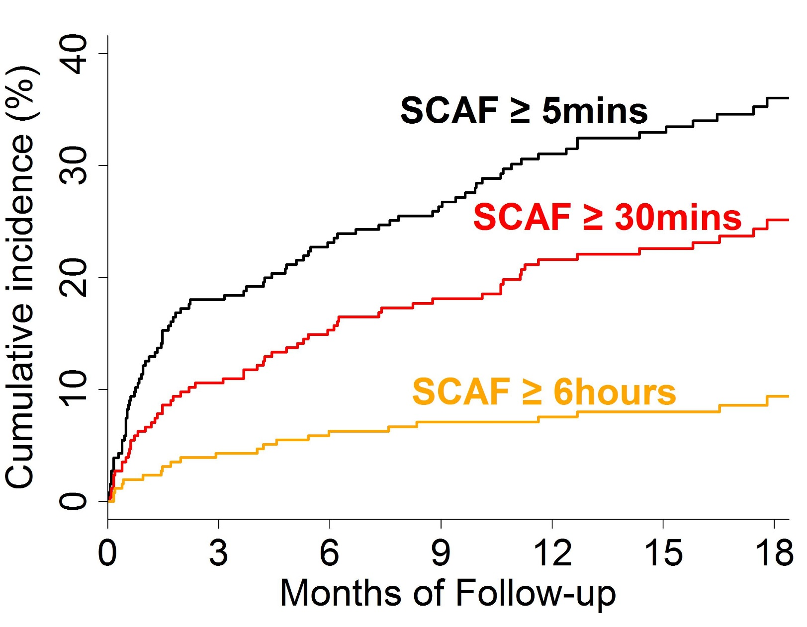
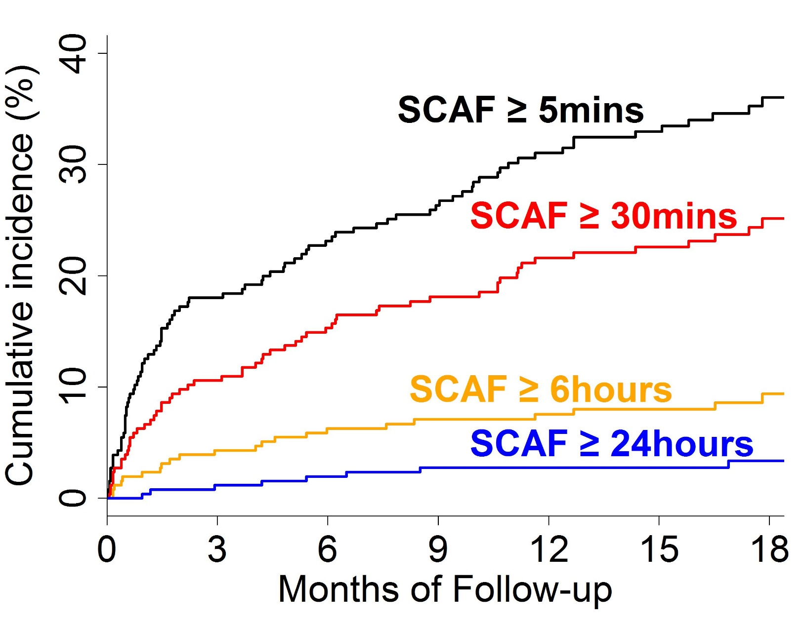
ASSERT-II: Incidence of SCAF
Rate per year (95% CI)
34.4% (27.7% – 42.3%)
21.8% (16.7% – 27.8%)
7.1% (4.5% – 10.6%)
2.7% (1.2% – 5.0%)

Slide 27
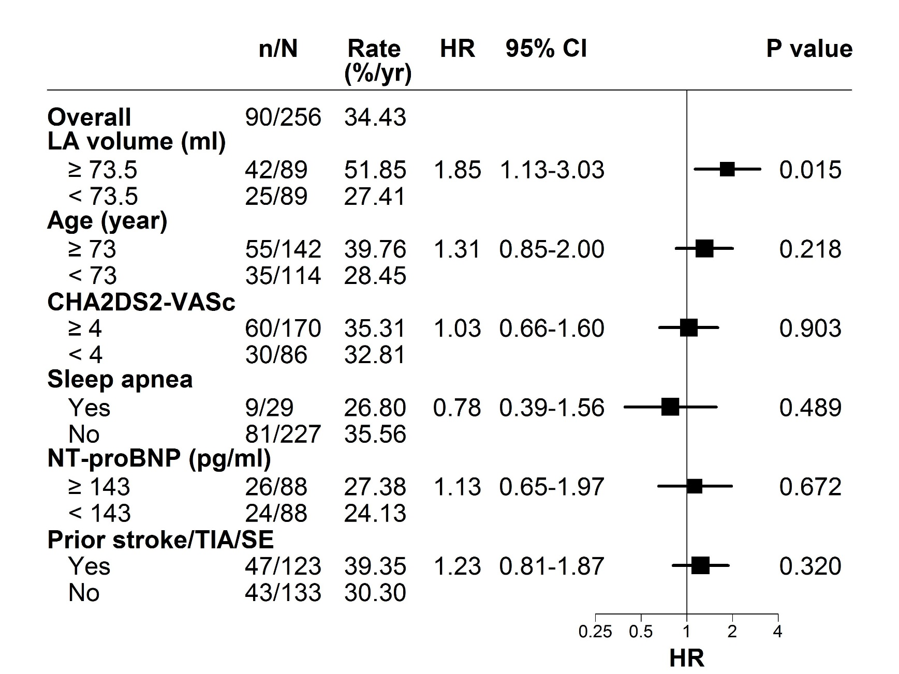
ASSERT-II: SCAF ≥ 5 Minutes by Sub-Group

Slide 28
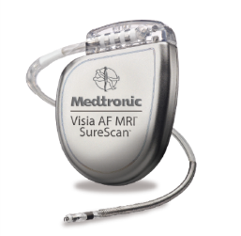
Merger of ILR and ICD AF Detection
Single chamber ICD with a traditional lead which enables physicians to continuously monitor, diagnose, and manage AF patients

Slide 29
New Questions Raised
Neutral result of NAVIGATE-ESUS
  Echo/Holter sub-study. HAVOC score
  Ongoing RESPECT-ESUS trial
Beneficial effect in COMPASS on ischemic stroke
  42% RRR
NOAH-AF and ARTESiA trials ongoing

Slide 30
Conclusions
Sub-clinical AF is common not only in patients with pacemakers, but more broadly in elderly individuals
  Possibly 25-30% of all individuals > 65 years
Sub-clinical AF is different from typical, clinical AF
  Stroke risk factor vs. risk marker?
  Ongoing trials will define the role of oral anticoagulation

