Slide 1



Winter Arrhythmia 2018
Saturday, 10th February 2018
Lunch Session 1: NOACs Matter
NOACs and Renal Failure
Robert P Giugliano, MD, SM, FACC, FAHA
Senior Investigator, TIMI Study Group
Physician, CV Medicine, Brigham and Women’s Hospital
Associate Professor of Medicine, Harvard Medical School

Slide 2
Disclosures
Grants to my institution:
  Amgen, Daiichi Sankyo, Merck
Honoraria for CME programs
  Amgen, Daiichi Sankyo, Merck
Consulting
  Amgen, Bristol Myers Squibb, Boeringer-Ingelheim, Daiichi Sankyo, Janssen, Pfizer, Portola

Slide 3
Danish Registries 1997-2008
146,251 pts discharged with NVAF
96.6% no renal disease
2.7% CKD (not end-stage)
0.7% CKD on renal replacement Rx

Slide 4
Guideline Recommendations in CKD and AF
2005 KDOQI guidelines recommendation¹ to use VKA in pts with CKD and AF is based on extrapolation (no RCTs in CKD 4/5) and small observations studies²
Some dialysis registries show ↑ stroke and death associated with warfarin^{3,4}
Latest DKIGO Clinical Update⁵ in 2011 stated:
  Benefit of OAC in 1°prevention of stroke in HD pts with AF is uncertain⁴
  VKA is recommended in pts with prior stroke/TIA
2014 ACC/AHA/HRS recs VKA in pts with CKD 4/5⁶
1 National Kidney Foundation KDOQI Guidelines Am J Kidney Dis;2005:45:S1-153 2. Yang Europace 2010:12:1666-72
3. Wizermann Kidney Int 2010:77:1098-106 4. Chan J Am Soc Nephrol 2009:2-:2223-33
5. Herzog, KDIGO Clinical Update, Kidney Int 2011 6. Jamuary J Am Coll Cardiol 2014;64:2246-80

Slide 5
Danish Registry: Outcomes in AF + CKD
Olesen et al, NEJM 2012;367:624-35

Slide 6
PK/PD of 4 NOACs in AF
 | Dabigatran | Rivaroxaban | Apixaban | Edoxaban
Target | IIa (thrombin) | Xa | Xa | Xa
Dosing | BID | QD | BID | QD
Bioavailability | 7% | 80%* | 66% | 62%
Hrs to C_{max} | 2 | 2-4 | 1-3 | 1-2
Transporters | P-gp | P-gp | P-gp | P-gp
Half-life | 12-14h | 9-13h | 8-15h | 10-14h
Renal elimination | 80% | 33%† | 27% | 50%
CYP metabolism | None | 32% | 15% | <4%
Protein binding | 35% | >90% | 87% | 55%
*Nearly 100% if taken with food
†Another 33% is excreted unchanged in the urine
CYP=cytochrome P450; NR=not reported; P-gp=P-glycoprotein
Gonzalez-Quesada and Giugliano. Am J Cardiovasc Drugs. 2014;14:111–27
Grip . Hot Topics. 2013:31:7-18
Plitt A. J Cardiovasc Pharmacol Ther. 2014;19(5):409-16
Ericksson BI. Clin Pharmacokinet. 2009; 48:1-22

Slide 7
Phase III AF Trials – Dose Comparisons
 | RE-LY | ROCKET-AF | ARISTOTLE | ENGAGE AF-TIMI 48
Drug | Dabigatran | Rivaroxaban | Apixaban | Edoxaban
N | 18,113 | 14,266 | 18,201 | 21,105
Dose (mg) Frequency | 150, 110 BID | 20 QD | 5 BID | 60, 30 QD
Initial dose reduction | No | 20 → 15 mg | 5 → 2.5 mg | 60 → 30 mg 30 → 15 mg
Dose reduction (%) | 0 | 21 | 4.7 | 25
Dose change after randomization | No | No | No | Yes (8.3%)
Design | PROBE | 2x blind | 2x blind | 2x blind
Connolly SJ. NEJM 2009; 361:1139-51
Patel MR. NEJM 2011; 365:883-91
Granger CB. NEJM 2011; 365:981-92
Ruff CR. AHJ 2010; 160:635-41
PROBE = prospective, randomized,
open-label, blinded end point evaluation

Slide 8
Meta-analysis of NOACs vs Warfarin in AF:
Major Endpoints
Stroke/SEE
Ischaemic stroke
Haemorrhagic stroke
Myocardial infarction
AIl-cause mortality
Major bleeding
Intracranial hemorrhage
Gastrointestinal bleeding
Pooled
NOAC
(events)
911/29,312
665/29,292
130/29,292
413/29,292
2022/29,292
1541/29,287
204/29,287
751/29,287
Pooled
Warfarin
(events)
1107/29,229
724/29,221
263/29,221
432/29,221
2245/29,221
1802/29,211
425/29,211
591/29,211
RR (95% CI)
0.81 (0.73–0.91)
0.92 (0.83–1.02)
0.49 (0.38–0.64)
0.97 (0.78–1.20)
0.90 (0.85–0.95)
0.86 (0.73–1.00)
0.48 (0.39–0.59)
1.25 (1.01–1.55)
P
<0.0001
0.10
<0.0001
0.77
0.0003
0.06
<0.0001
0.043
0.2
0.5
1
2
Favors NOAC
Favors warfarin
Ruff et al. Lancet 2014;383:955–62

Slide 9
Renal Factors and Outcomes with OACs in Pts with AF and Mild-Moderate Renal Failure
Chan J Am Coll Cardiol 2016;67:2888-99

Slide 10
Meta-analysis of NOACs vs Warfarin: Subgroups by Renal Function
Stroke/SEE
Risk Ratio (95% CI)
P-Interaction
CrCl
(ml/ min)
<50
0.79 (0.65–0.96)
P=0.12
50–80
0.75 (0.66–0.85)
>80
0.98 (0.79–1.22)
0.5
1
2
Favors NOAC
Favors Warfarin
Major Bleeding
CrCl
(ml/min)
<50
0.74 (0.52–1.05)
P=0.57
50–80
0.91 (0.76–1.08)
>80
0.85 (0.66–1.10)
0.2
0.5
1
2
Favors NOAC
Favors Warfarin
Ruff et al. Lancet 2014;383:955–62

Slide 11
Renal Function, Drug-Drug Interactions and Dose
NOAC | Normal Dose in AF | Reduced Dosage
Dabigatran¹ | 150 or 110 mg BID | None in EU; 75 mg BID in US for CrCl <15-30 mL/min
Rivaroxaban² | 20 mg QD with dinner | 15 mg QD with evening meal (CrCl 15–50 mL/min) Avoid use with P-gp + CYP 3A4 inducer/inhibitor
Apixaban³ | 5 mg BID | 2.5 mg BID (≥2 of the following: age ≥80 y; weight ≤60 kg; SCr ≥1.5 mg/dL OR strong dual inhibitors P-gp and CYP 3A4) Avoid use with strong dual inducers of P-gp and CYP 3A4
Edoxaban⁴ | 60 mg QD | 30 mg QD (CrCl 15–50 mL/min) Avoid use with rifampin
Kovacs RJ et al. J Am Coll Cardiol. 2015;65:1340–60
1. Pradaxa (dabigatran) [prescribing information]. Boehringer Ingelheim Pharmaceuticals Inc; 2015
2. Xarelto (rivaroxaban) [prescribing information]. Janssen Pharmaceuticals, Inc; 2016
3. Eliquis (apixaban) [prescribing information]. Bristol-Myers Squibb Co; 2015
4. Lixiana (edoxaban) [prescribing information Daiichi Sankyo, Inc.; 2016
BID=twice daily; NOAC=non-vitamin K antagonist oral anticoagulant; QD=once daily; SCr=serum creatinine
Notes:
Please mention that the 75 mg dose was not studied in the RE-LY trials.

Slide 12
Monitoring Renal Function with NOACs
Monitor renal function regularly
Adapt the dose accordingly
Monitor renal function at the following intervals:
Yearly | CrCl ≥60 ml/min
Every 6 months | Elderly (≥75 yrs) or frail patients (especially if on dabigatran, edoxaban, rivaroxaban)
Every X months | CrCl ≤60 ml/min: recheck interval=CrCl/10 (Example: CrCl=30 ml/min; recheck every 3 months)
Adapted from Heidbuchel et al. Europace. 2015;17:1467–507

Slide 13
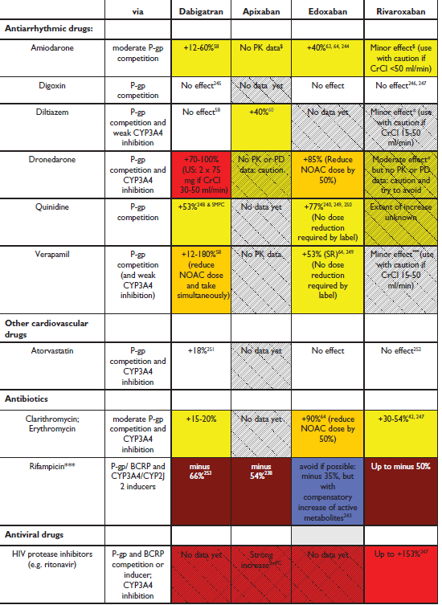
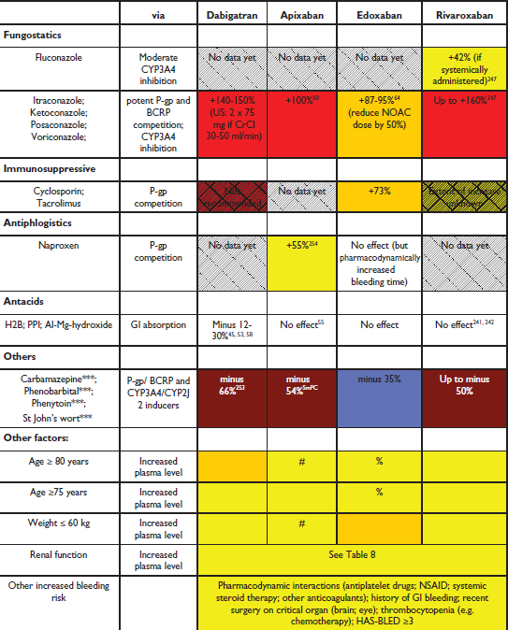
Drug-drug Interactions with NOACs
The Complicated View
Avoid
Avoid
Reduce dose
Consider reduced dose
Not relevant
No data
Heidbuchel et al. Europace. 2015;17:1467–507

Slide 14
Drug-drug Interactions with NOACs
Giugliano’s Easy Summary
 | Avoid | Reduce | Unknown | OK
Dabigatran | 6 | 4 | 2 | 4
Rivaroxaban | 4 | 8 | 1 | 3
Apixaban | 4 | 4 | 7 | 1
Edoxaban | 1 | 7 | 2 | 6

Slide 15
Timing of Cessation of NOAC Pre-Procedure
 | Dabigatran |  | Apixaban- Edoxaban-Rivaroxaban
 | No important bleeding risk and/or adequate local hemostasis possible: perform at trough level (ie, ≥12 or 24 h after last intake)
 | Low risk | High risk | Low risk | High risk
CrCl ≥80 mL/min | >24 h | >48 h | >24 h | >48 h
CrCl 50-80 mL/min | >36 h | >72 h | >24 h | >48 h
CrCl 30-50 mL/min | >48 h | >96 h | >24 h | >48 h
CrCl 15-30 mL/min | >72 h* | >120 h* | >36 h | >48 h
CrCl <15 mL/min | No official indication for use
There is no need for bridging with LMWH/UFH in most cases
Bold values deviate from the common stopping rule of ≥24 h low risk, ≥48 h high risk.
* In US the dose of dabigatran should be 75 mg BID for CrCl 15-30.
Adapted from Heidbuchel H et al. Europace. 2015 Aug 31. pii: euv309. and . Kovacs RJ et al. Practical Management of Anticoagulation in Patients With Atrial Fibrillation, JACC 2015; ;65:1340–60

Slide 16
Reversal agents for NOACs
Agent | Mechanism of Action | Status
Idarucizumab | Antibody fragment that mimics thrombin; has an affinity for dabigatran approximately 350 times stronger than the affinity of dabigatran for thrombin | Approved in EU and NA
Andexanet alfa (PRT064445) | Protein catalyst mimics the appearance of factor Xa and thereby binds the direct Xa inhibitors | Fast track designation Phase 3 (May 2018 FDA response?)
Ciraparantag | Binds both the direct thrombin and factor Xa inhibitors without binding blood coagulation factors | Studies ongoing
4F-PCC | Directly or indirectly enhances thrombin generation | Phase 3
Schiele et al. Blood. 2013;121:3554–62; Lu et al. Nat Med. 2013;19:446–51;
Ansell et al. N Engl J Med. 2014;371:2141-2; Mo & Yam. Pharmacotherapy. 2015;35:198–207;
Pollack et al. N Engl J Med. 2015;373:511–20; Eerenberg et al. Circulation. 2011;124:1573–9
4F-PCC, 4 factor prothrombin complex concentrate

Slide 17
Dabigatran and Rivaroxaban in ESRD:
On HD, with AF, and Treated with OAC
Chan Circulation;2015;131:972-9
2010 2011 2012 2013 2014 2015

Slide 18
NOACs Use Among Anticoagulated Patients with AF + Advanced CKD
Chan J Am Coll Cardiol 2016;67:2888-99

Slide 19
Apixaban PK in Patients in Hemodialysis
2.5 mg BID given for 8 days
Day 8 AUC with 2.5 and 5 mg BID
90th percentile
5mg BID, normals
10th percentile
5mg BID, normals
AUC triples (accumulation)
2.5 mg → AUC is too low (10th %ile)
5 mg → AUC is too high (>90th %ile)
Mavrakanas J Am Soc Naphtol 2017

Slide 20
Conclusions: NOACs and Renal Failure
Pts with AF and CKD are at high risk stroke, bleeding, death
CKD 4/5: Warfarin recommend (?benefit in 1° prevention)
CKD 3: All NOACs are effective and can be used safely in pts with CrCl 30-50 mL/min, BUT REMEMBER
  Use appropriate dose (Dabi 110, Riva 15, Apixa* 5 or 2.5, Edox* 30)
  Measure renal function 2-4x per year (In X mths, X = CrCl/10)
  Review all concomitant medications (CYP interaction Riva, Apixa)
  High-risk procedures: Hold FXai for > 48h, longer for Dabi and for pts with CrCl <30 mL/min
Avoid NOACs (?except apixa 2.5) in CKD 5 / hemodialysis
* Apixa and edox have less bleeding than warfarin

Slide 21
Back-up

Slide 22
Stroke/SEE in Each Trial by CrCl
RE-LY D110 v warfarin D150 v warfarin
ROCKET-AF Riva v warfarin
ARISTOTLE Apixa v warfarin

Slide 23
Stroke or SEE by Baseline CrCL in ENGAGE AF-TIMI 48 mITT On-Treatment
 |  |  | Event rate, %/yr | Edoxaban 60/30 mg vs warfarin
Creatinine clearance | N | n |  | HR (95% CI)
Moderate (30 - 50)
Warfarin | 1305 | 49 | 1.97
Edoxaban 60/30 mg | 1302 | 43 | 1.72 | 0.88 (0.58, 1.32)
Mild (> 50 - < 80)
Warfarin | 3048 | 135 | 2.00
Edoxaban 60/30 mg | 3007 | 71 | 1.07 | 0.53 (0.40, 0.70)
Normal (≥ 80)
Warfarin | 2608 | 47 | 0.76
Edoxaban 60/30 mg | 2633 | 66 | 1.06 | 1.41 (0.97, 2.06)
← Edoxaban
60/30 mg better
Warfarin →
better
Pint 0.0002

Slide 24
Bleeding in Each Trial by CrCl
RE-LY
CrCl (ml/min) | D110 | D150 | Warf | HR: D110 v Warf | P-int | HR: D150 v Warf | P-int
<50 | 5.13% | 6.06% | 5.06% | 1.02 (0.78-1.33) | 0.018 | 1.22 (0.95-1.58) | 0.004
50-80 | 2.78% | 3.05% | 3.38% | 0.82 (0.68-0.99) |  | 0.90 (0.75-1.09)
>80 | 0.51% | 0.77% | 1.64% | 0.50 (0.16-0.57) |  | 0.47 ().27-0.80)
ROCKET-AF Riva v warfarin (Major or clinically relevant non-major bleeding)
ARISTOTLE Apixa v warfarin

Slide 25
Major Bleeding by Baseline CrCL in ENGAGE AF-TIMI 48 mITT On-Treatment Edoxaban 60/30-mg Group
 |  | Event (n) Event rate, %/yr |  |  |  |  | Edoxaban 60/30 vs warfarin HR (95% CI)
 | N | Edoxaban |  |  | Warfarin
 |  | n | %/yr |  | n | %/yr
Major bleeding
Moderate (30 - 50) | 2607 | 96 |  | 3.91 | 128 | 5.23 | 0.75 (0.58, 0.98)
Mild (> 50 - < 80) | 6055 | 209 |  | 3.20 | 207 | 3.55 | 0.90 (0.75, 1.08)
Normal (≥ 80) | 5241 | 109 |  | 1.77 | 154 | 2.52 | 0.71 (0.55, 0.90)
← Edoxaban
60/30 mg better
Warfarin →
better
Pint 0.2501

Slide 29
Metanalysis of All NOACs vs Warfarin:
Stroke or SEE
Risk Ratio (95% CI)
RE-LY
0.66 (0.53 - 0.82)
[150 mg]
ROCKET AF
0.88 (0.75 - 1.03)
ARISTOTLE
0.80 (0.67 - 0.95)
ENGAGE AF-TIMI 48
0.88 (0.75 - 1.02)
[60 mg]
Combined
0.81 (0.73 - 0.91)
[Random Effects Model]
p=<0.0001
N=58,541
0.5
Favors NOAC
1
2
Favors Warfarin
Heterogeneity p=0.13
Ruff CT, et al. Lancet 2014;383:955-962

Slide 30
Secondary Efficacy Outcomes
Risk Ratio (95% CI)
Ischemic Stroke
0.92 (0.83 - 1.02)
p=0.10
Hemorrhagic Stroke
0.49 (0.38 - 0.64)
p<0.0001
MI
0.97 (0.78 - 1.20)
p=0.77
All-Cause Mortality
0.90 (0.85 - 0.95)
p=0.0003
0.2
0.5
1
2
Favors NOAC
Favors Warfarin
Heterogeneity p=NS for all outcomes
Ruff CT, et al. Lancet 2014;383:955-962

Slide 31
Meta-analysis of NOACs vs Warfarin:
Major Bleeding
Risk ratio (95% CI)
RE-LY
[150 mg]
0.94 (0.82–1.07)
ROCKET AF
1.03 (0.90–1.18)
ARISTOTLE
0.71 (0.61–0.81)
ENGAGE AF-TIMI 48
[60 mg]
0.80 (0.71–0.90)
Combined
0.86 (0.73–1.00)
[Random Effects Model]
p=0.06
N=58,498
0.5
1
2
Favors NOAC
Favors Warfarin
Heterogeneity p=0.001
Ruff et al. Lancet 2014;383:955–62

Slide 32
Secondary Safety Outcomes
Risk Ratio (95% CI)
ICH
0.48 (0.39 - 0.59)
p<0.0001
1.25 (1.01 - 1.55)
GI Bleeding
p=0.043
0.2
0.5
1
2
Favors NOAC
Favors Warfarin
Heterogeneity
ICH, p=0.22
GI Bleeding, p=0.009
Ruff CT, et al. Lancet 2014;383:955-962

