Slide 1


Founding Fathers: What did they call AF ?
Kamran Ahmad MD MSc FRCPC
Cardiology/Cardiac Electrophysiology
St. Michael’s Hospital
Toronto ON Canada

Slide 2
Outline
Ancient clues from the pulse
Western medicine in its infancy
Pre-ECG insights
The electrical era (Einthoven and after)
Beginnings of the modern science of atrial fibrillation
  Mechanisms
  Therapy

Slide 3
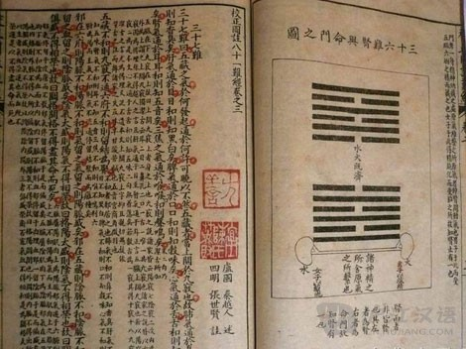
Traditional Chinese Medicine
Yellow Emperor's Classic of Internal Medicine(Huang Ti Nei Ching Su Wen) (c 2650 BC).

Slide 4
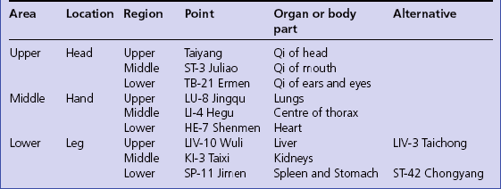
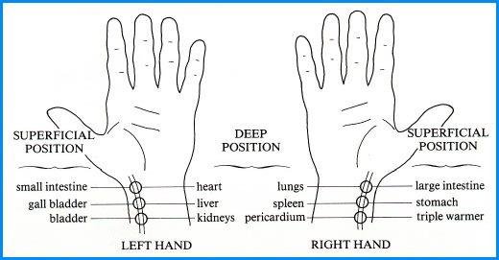
Pulse was central to diagnosis
Pulse should be taken at dawn
“When the pulse is irregular and tremulous and the beats occur at intervals, then the impulse of life fades
BMJ 1995;311:1361

Slide 5
Moses Maimonides
Aphorisms on the pulse (c. 1187 AD)
  Inequality of the pulse is in most cases accompanied by irregularity; one hardly ever finds a regular, unequal pulse (? Atherosclerosis)
  All types of pulses which are irregular in more than one beat are a direct result of an abnormal constitution of the heart which is also irregular or due to an affliction arising in one’s stomach or in one’s strength (? Vagal atrial fibrillation)
Maimonides’ Medical Writings.

Slide 6
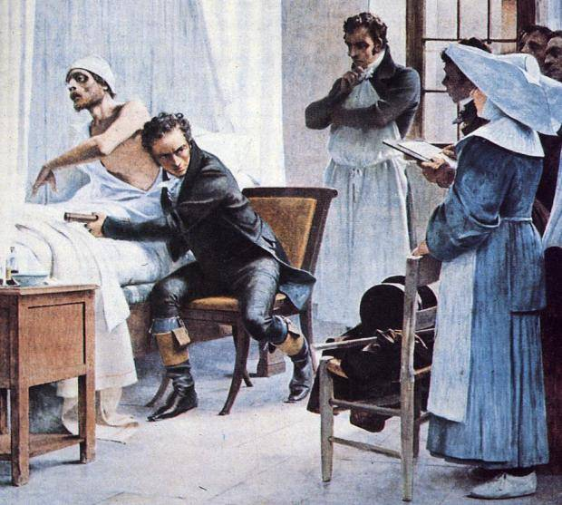
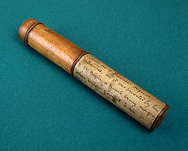
Laennec – original stethoscope
Functional appreciation of valvular disease (particularly mitral stenosis)
Heartbeat vs. peripheral pulse
Pulse was an “unreliable guide” to the state of the circulation

Slide 7
Modern, pre-ECG insights
Adams, 1827: Probably the first to recognize the condition clinically but as a “sign of mitral stenosis”
Hope, 1839: Identified irregular pulse in association with mitral stenosis--exercise worsened the total irregularity, whereas it abolished an intermittent pulse
Marey, 1863: Published a pulse tracing of atrial fibrillation from a patient with mitral stenosis

Slide 8
Mackenzie J. 1907: – Simultaneous tracings of jugular and radial pulses in patients with an irregularly irregular rhythm – absent a waves

Slide 9
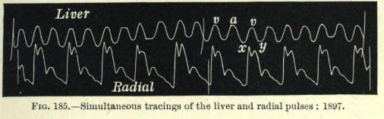
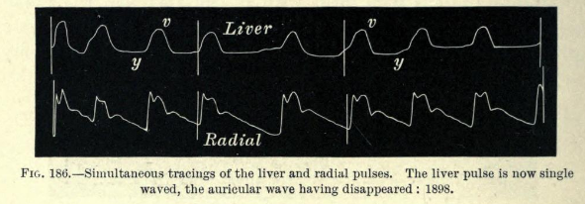
Loss of a wave in mitral stenosis patient
Note change to an irregular rhythm
Mackenzie 1902

Slide 10
Modern, pre-ECG era
By late 19th/early 20th century: pulsus irregularis continualis
  Absolute irregularity of the pulse
  Persistence of the rhythm
  Absence of venous a waves (no demonstrable atrial activity)

Slide 11
Direct observations of fibrillation
Human VF – 17th century observations of fatal, open chest wounds – “terminal fibrillation” described in the ventricles
“Faradic current” applied to animal hearts – VF induced and described
1874: Vulpian creates the same phenomenon in animal atria

Slide 12
William Harvey 1628
On observing the auricles of the dying heart of an animal:
“…but I noticed that after the heart proper, and even the right auricle were ceasing to beat and appeared on the point of death, an obscure movement, undulation, or palpitation had clearly continued in the right auricular blood itself for as long as the blood was perceptibly imbued with warmth and spirit”

Slide 13
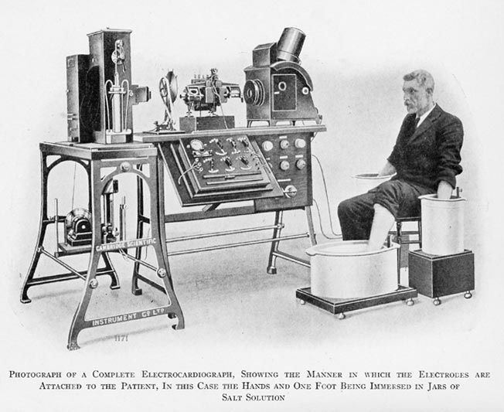
ECG era
Einthoven – string galvanometer - 1900
First attempted AF recording 1906. Irregular QRS, but too much background noise to identify AF

Slide 14
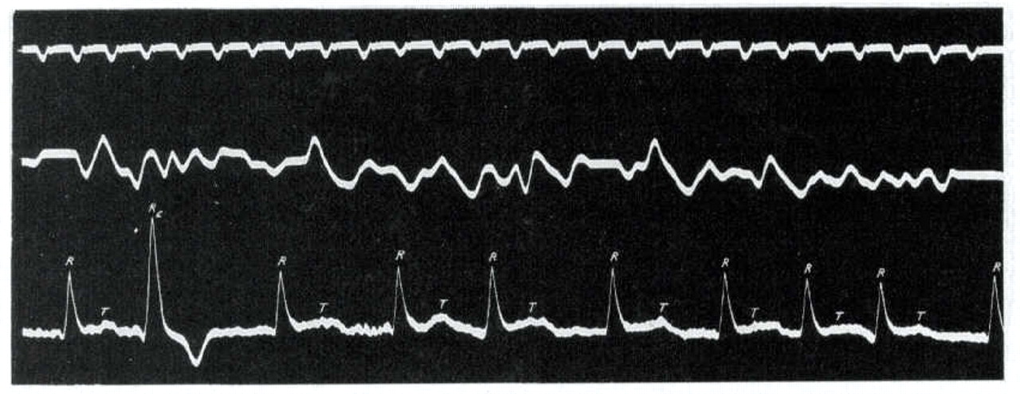
First electrical recording of AF
Hering 1908

Slide 15
Putting electrical and mechanical together
Rothberger and Winterberg 1909. Compared animal AF tracings with human. Three main points of similarity
  Irregularly irregular ventricular rhythm
  Absence of p-waves
  Irregular oscillations of galavnometer baseline

Slide 16
Electrical theories
Focal origin theories (as early as 1906 – Winterberg and Lewis)
  Rapid foci (3000 cpm) responsible for Afib while less rapid (500 cpm) caused atrial flutter
Rothberger, Lewis, Winterberg – Atrial tissue had to have a shorter refractory period
  Demonstrated in dog hearts
  Thought to be due to vagal effect (Acetylcholine dependent K channel)

Slide 17
Multiple foci. Engelman 1895
Each heart fiber:
  Becomes independently rhythmic
  Is focus of its own impulse formation
  Has increased excitability
Reasoning:
  One focus intermittently – PACs
  One focus persistently – Atach
  Multiple foci – Afib
“Multiple Heterotopus centers Theory”

Slide 18
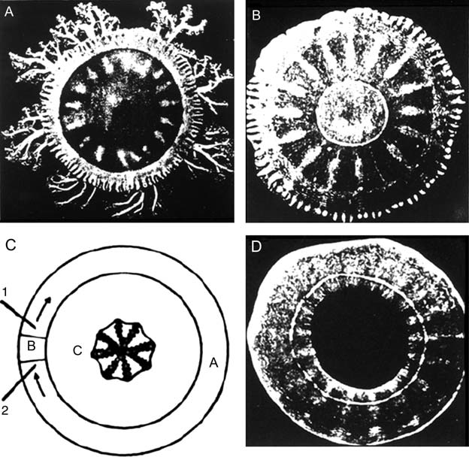
“Circus movement”
Important insight into the reentrant mechanism of arrhythmias. Experiments done with rings of excitable tissue from jellyfish “subumbrella” (Meyer)
The isolated disc can be stimulated mechanically or electrically to trigger a circular wave of current which may continue doing so for hours or days
Cardiovascular Research (2011) 89, 766–775

Slide 19
Circus movement
Similar observations with rings of tortoise heart
Proposals that a closed circuit could exist in a fibrillating heart much longer than the wavelength of the activation front
Indefinite circus movement could be the underlying mechanism of AFib

Slide 20
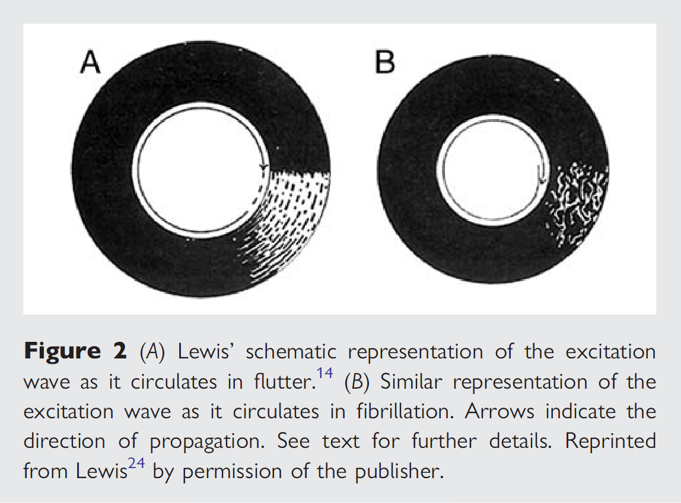
Br Med J 1921;1:551–555

Slide 21
Critical mass
Garrey 1914: Sectioned a fibrillating section of myocardial tissue into four pieces
  They all kept fibrillating
    Evidence against a single focus
  A critical mass of tissue was needed to fibrillate
    Evidence against multiple, single fiber foci

Slide 22
Garrey and conduction block
Could demonstrate single impulses conducting across narrow bands of tissue but not fibrillation
Hypothesised that shifting, dynamic conduction block existed
Circus movement “circles” were therefore constantly undulating and finding new paths through the transient block

Slide 23
Circus movement… not evident experimentally
Scherf – induced afib by injecting blister of aconitine near SA node. Cooling/warming the area stopped/restarted AF
  Incompatible with circus movement (circuit would have cooled and AF terminated permanently)
Prinzmetal – High speed filming + electrograms showed AF spreading out from focus. No circus movement, or mother/daughter waves seen

Slide 24
Multiple wavelet
Moe 1959: Found both focal and circus movement theories inadequate to explain AF mechanisms (and its chronicity)
Multiple wavelet hypothesis
  “The grossly irregular wave front becomes fractionated as it divides about islets or strands of refractory tissue, and each of the daughter wavelets may now be considered an independent offspring. Fully developed fibrillation would then be a state in which many such randomly wandering wavelets coexist”

Slide 25
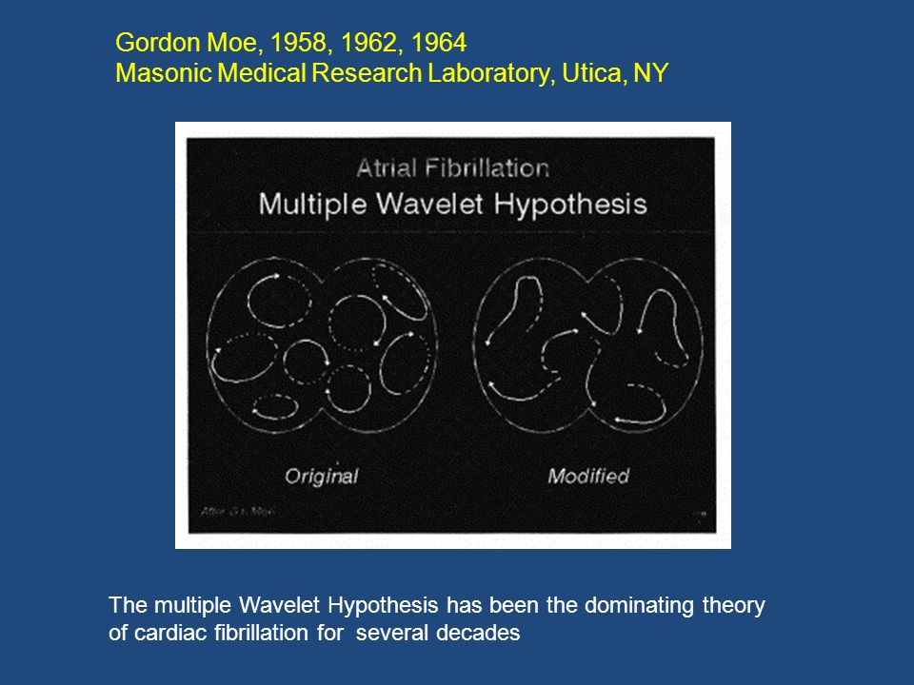

Slide 26
G. Moe: Multiple wavelet hypothesis
Model required 15-30 simultaneous wavelets to reliably sustain AF
When the number dropped below this AF would extinguish itself
Alessie developed “leading circle” conception of the wavelet
Canine studies suggested only ~6 were required to sustain AF

Slide 27
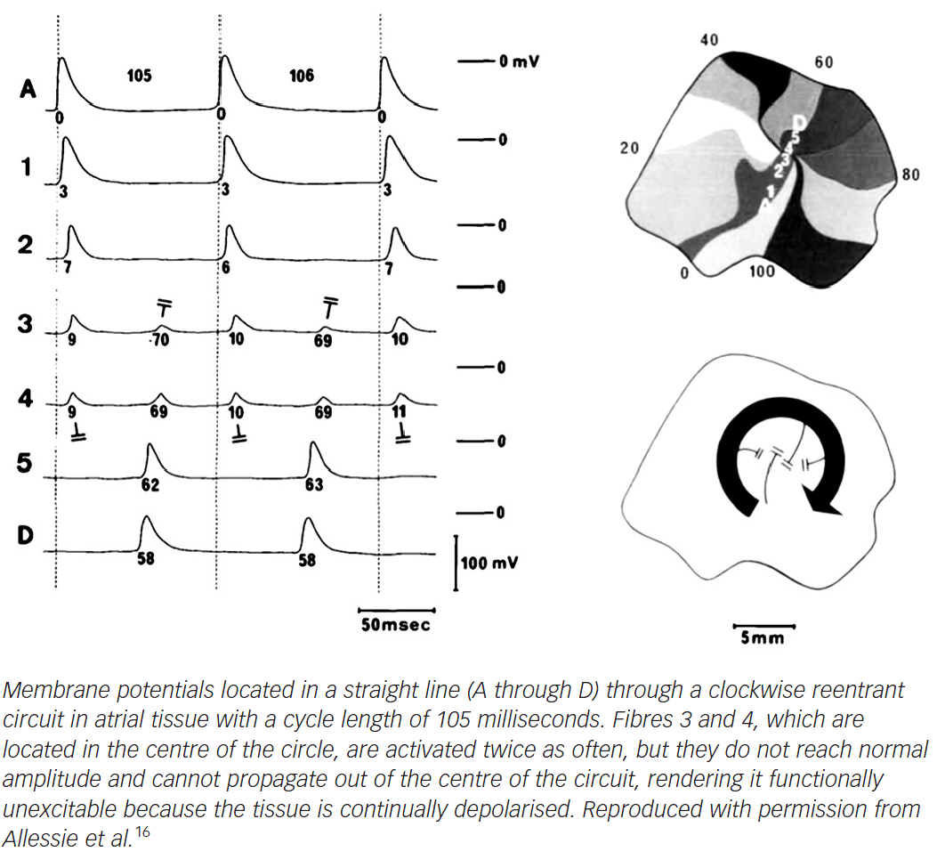
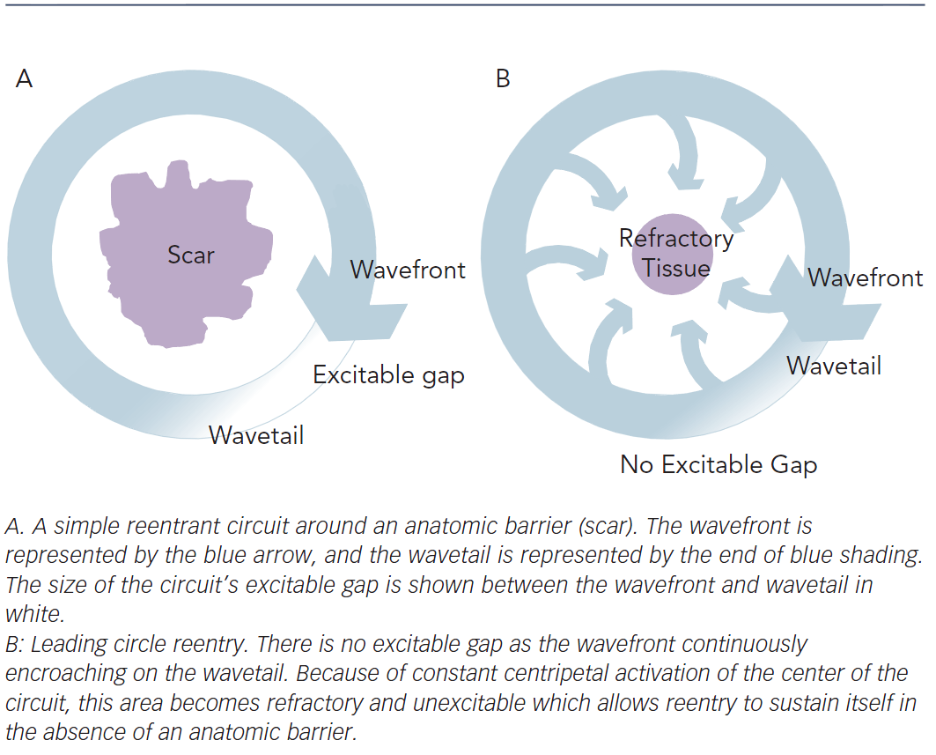
“Leading Circle” reentry
Arrhythmia & Electrophysiology Review 2014;3(2):90–100

Slide 28
Incompatibility with observed AF
Leading circle’s refractory center should not drift about
Optical and other forms of mapping demonstrated the center of wavefronts to drift and meander

Slide 29
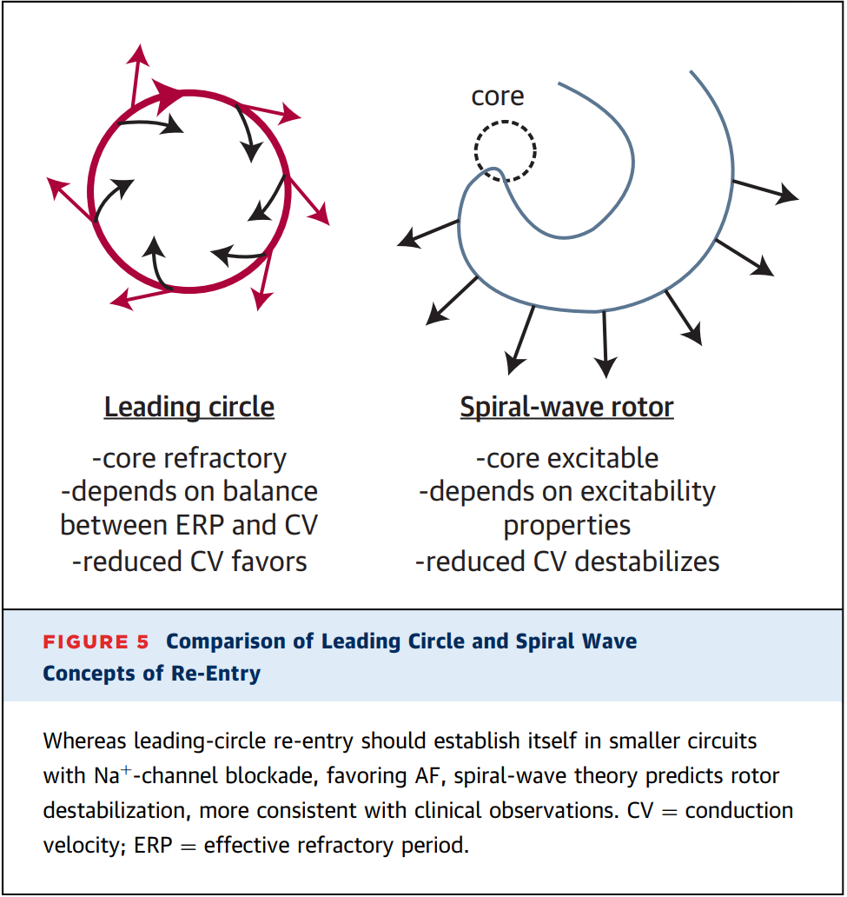
Leading circle vs. spiral wave

Slide 30
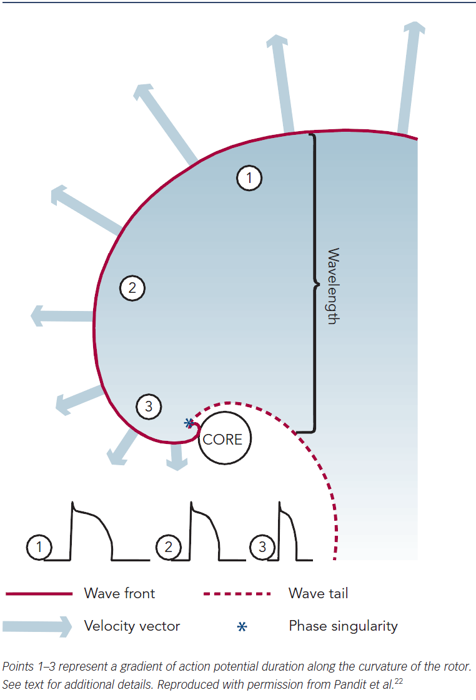
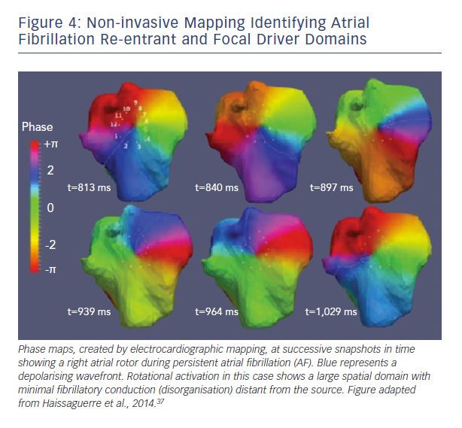
Rotors
Circulation 2014;130(7):530–8

Slide 31
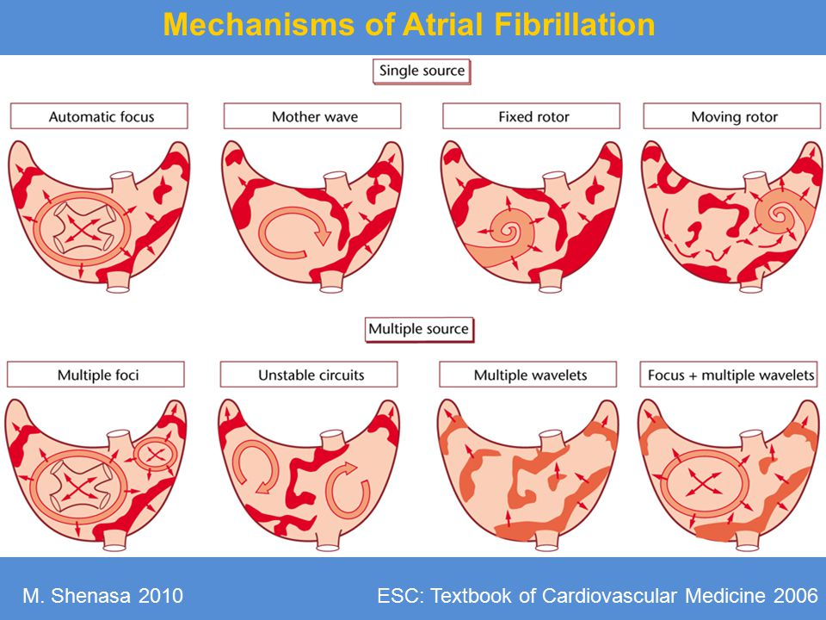

Slide 32
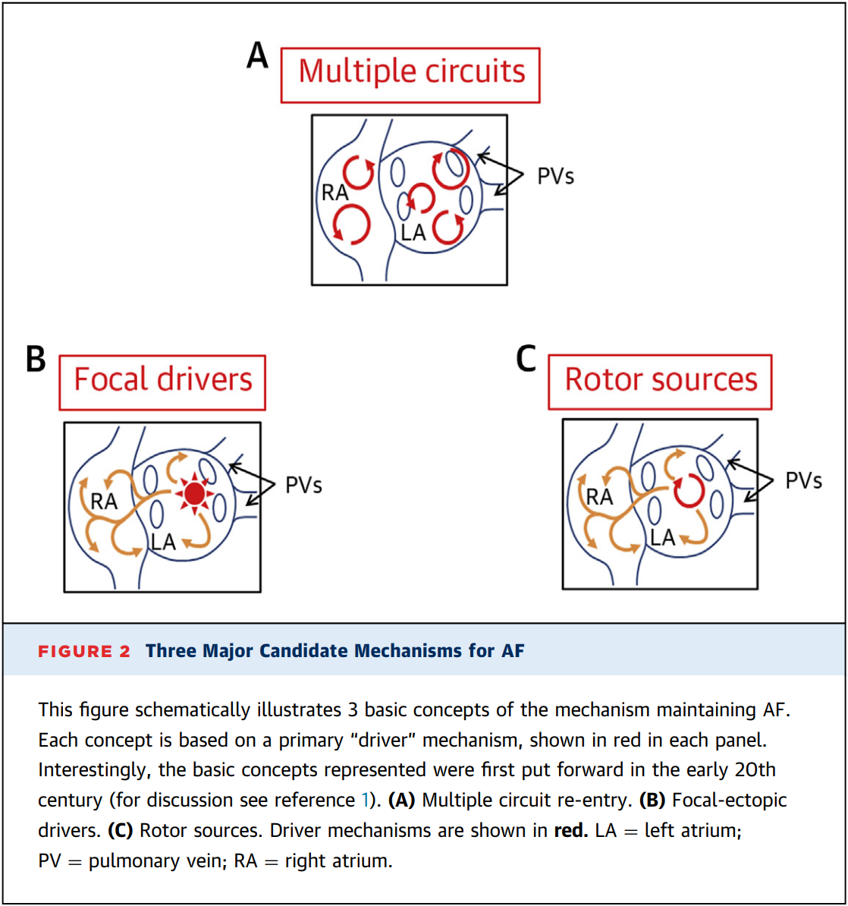

Slide 33
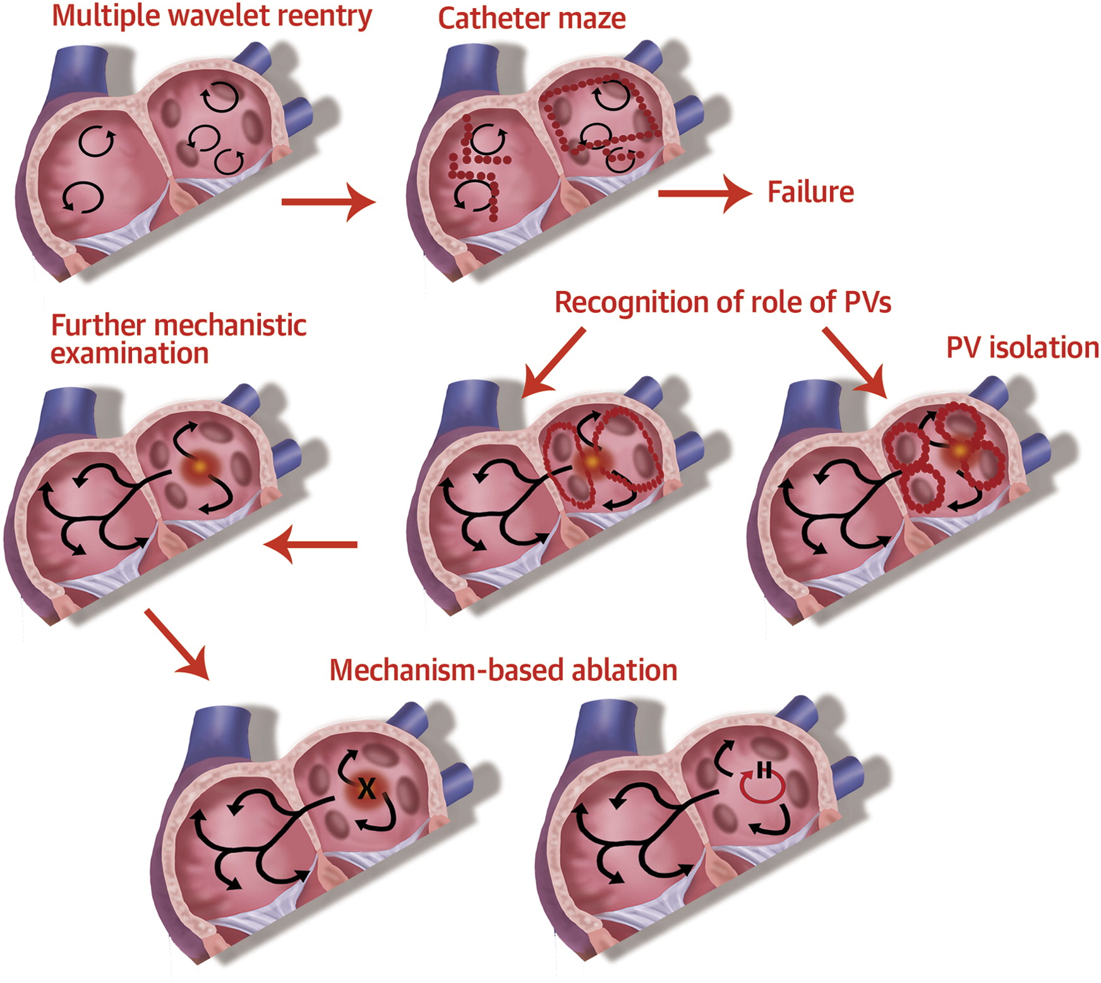
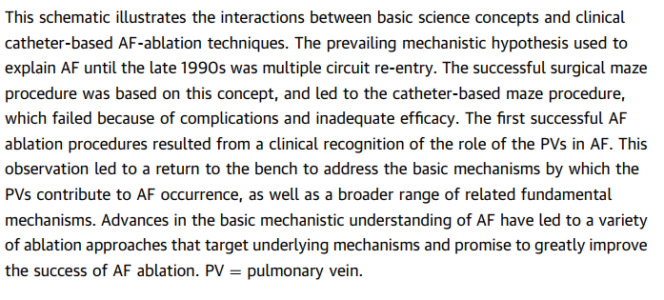
JACC VOL. 64, NO. 8, 2014

Slide 34
How far have we come?
“The history of the recognition of fibrillation of the auricles will impress you with the dimness of our eyes and the opacity of the obstacles which embarrass our vision”
  Sir Thomas Lewis 1912

Slide 35
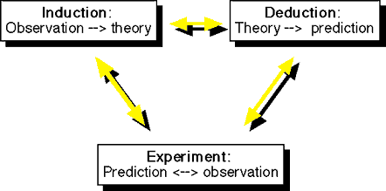
Are we rigorous enough with our reasoning with Afib?
Hume “Empiricist”
Descartes “Rationalist”
Bacon “Scientific Method

Slide 36
“Inspired” insights into afib
We remain impressed by:
  Careful, detailed observations
  Theories which account for the complete set of observations
  Predictions which are validated by experimental evidence and/or new observations

Slide 37
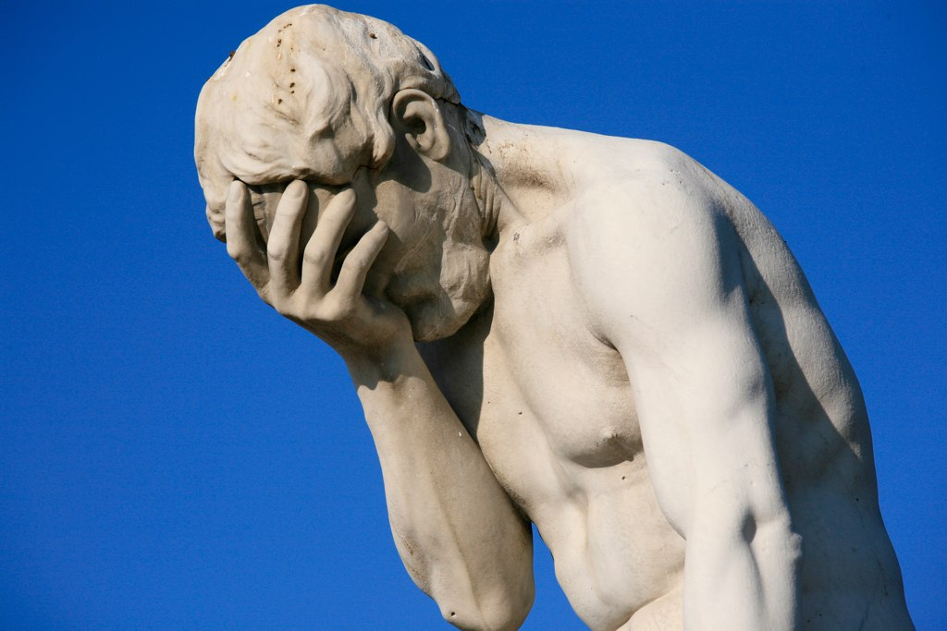
We are embarrassed by
Incomplete, selective observations
Theories which are overreaching, heavy on conjecture or preconception, not informed by observation
Predictions which are accepted as fact without sufficient experimental or observational scrutiny
Facepalm – Tuileries gardens, Paris

Slide 38
A last bit of editorializing…
Refine our observational ability
  Ongoing basic science investigation of AF
  Inform therapeutics as much possible by clinical science
Strive for rigor when formulating theories to account for observations
  Avoid foregone conclusions and assumptions about mechanisms, effect of therapies
Continue to test predictions with evidence at a level consistent with contemporary evidence based medicine

Slide 39
Thank you
Discussion/questions…

