Slide 1
AF & Exercise
Paula Harvey, BMBS, PhD, FRACP
Women’s College Hospital
Department of Medicine
University of Toronto

Slide 2
FACULTY/PRESENTER DISCLOSURE
Faculty: Paula Harvey
Relationships with commercial interests: Nil
Notes:
This slide must be visually presented to the audience AND verbalized by the speaker.

Slide 3
Objectives
In this session we will review:
Association between baseline fitness and AF incidence/recurrence/complications
Exercise training (different types?) as a possible therapeutic intervention in AF
Potential mechanisms for therapeutic effect
Dose response – can there be too much of a good thing?
Recommendations for exercise as an AF intervention?

Slide 4
Specific Benefits of Exercise Training
Improvement in CV risk factors include
  ↓ obesity and ↑ insulin sensitivity
  ↑ HDL, TG, (↓LDL)
  ↓ SBP, DBP, PP
  ↓ depression and psychological stress, ↑ QoL
Other vascular & hematological
  Improves endothelial function (NO bioavailability)
  ↓ inflammation
  ↑ fibrinolytic activity
  ↑ coronary flow reserve
  ↑ ventricular fibrillation threshold
  Improves autonomic modulation (chronic ↑ vagal tone)
Reduces recurrent CV events, CV mortality, all cause mortality
Lavie CJ et al. Mayo Clin Proc. 2009;84(4):373-383.
Notes:
Physically active people live on avery 7 years longer than physically inactive contemporaries!

Slide 5
Benefits of Exercise in AF?
Despite all of these benefits – exercise is not prescribed for patients with AF even though risk factors for AF overlap with CAD (eg. obesity, ↑BP, diabetes, ↑ lipids, sedentary)
Furthermore, AF associated with:
Impairment of QoL compared to general population & even compared with patients post MI and Post PCI
Symptoms of ↓ exercise tolerance plus fatigue, dyspnea
  These symptoms → weight gain with adverse impact on cardiovascular risk factor profile (and ↑AF…)
  Further ↓ QoL
Significant morbidity and mortality from CHF, cardio-embolic stroke
Miller JD et al. JACC 2015;66:2899-906

Slide 6
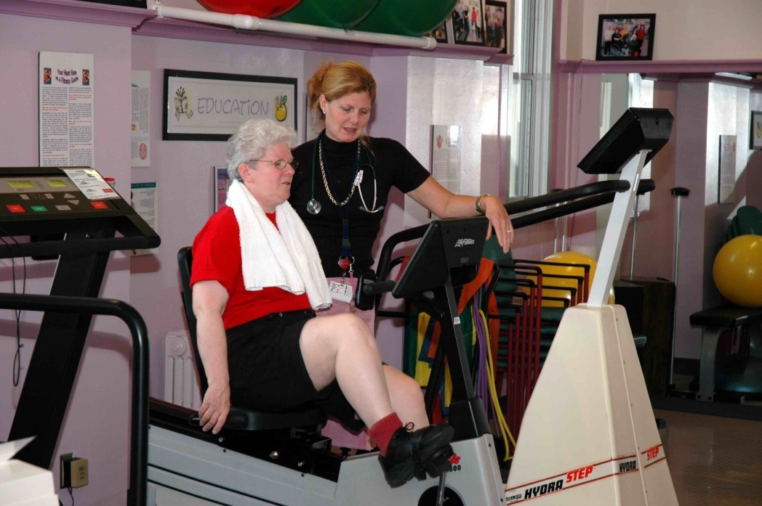
Exercise as Medicine in AF?
Pillars of AF management
Rate control
Rhythm control
Anticoagulation
Risk Factor Modification – exercise intervention?
2013 - Heart Rhythm Society stated research on risk factor modification in AF should be a priority
Notes:
2013 – priority of Heart Rhythm Society to

Slide 7
Exercise Capacity & Incident AF
Cardiorespiratory fitness (CRF) and incident AF in large multi-racial cohort that underwent graded exercise treadmill testing (GXT).
1991 to 2009, 64 561 adults (mean age, 54.5±12.7 years; 46% female; 64% white) without AF
Incident AF confirmed by linkage to medical claim files.
Nested, multivariable Cox proportional hazards models to estimate the independent association of CRF with incident AF.
median follow-up of 5.4 yrs (3–9 yrs)
Qureshi WT et al. Circulation 2015;131:1827-34

Slide 8
Exercise Capacity & Incident AF
4616 new cases of AF diagnosed.
Adjusted for confounders, 1 higher MET achieved associated with a 7% lower risk of incident AF (hazard ratio, 0.93; 95% confidence interval, 0.92–0.94; P<0.001).
Remained significant after adjustment for incident CAD.
The magnitude of the inverse association between CRF and incident AF was greater among obese compared with non-obese (P for interaction=0.02).
Qureshi WT et al. Circulation 2015;131:1827-34

Slide 9
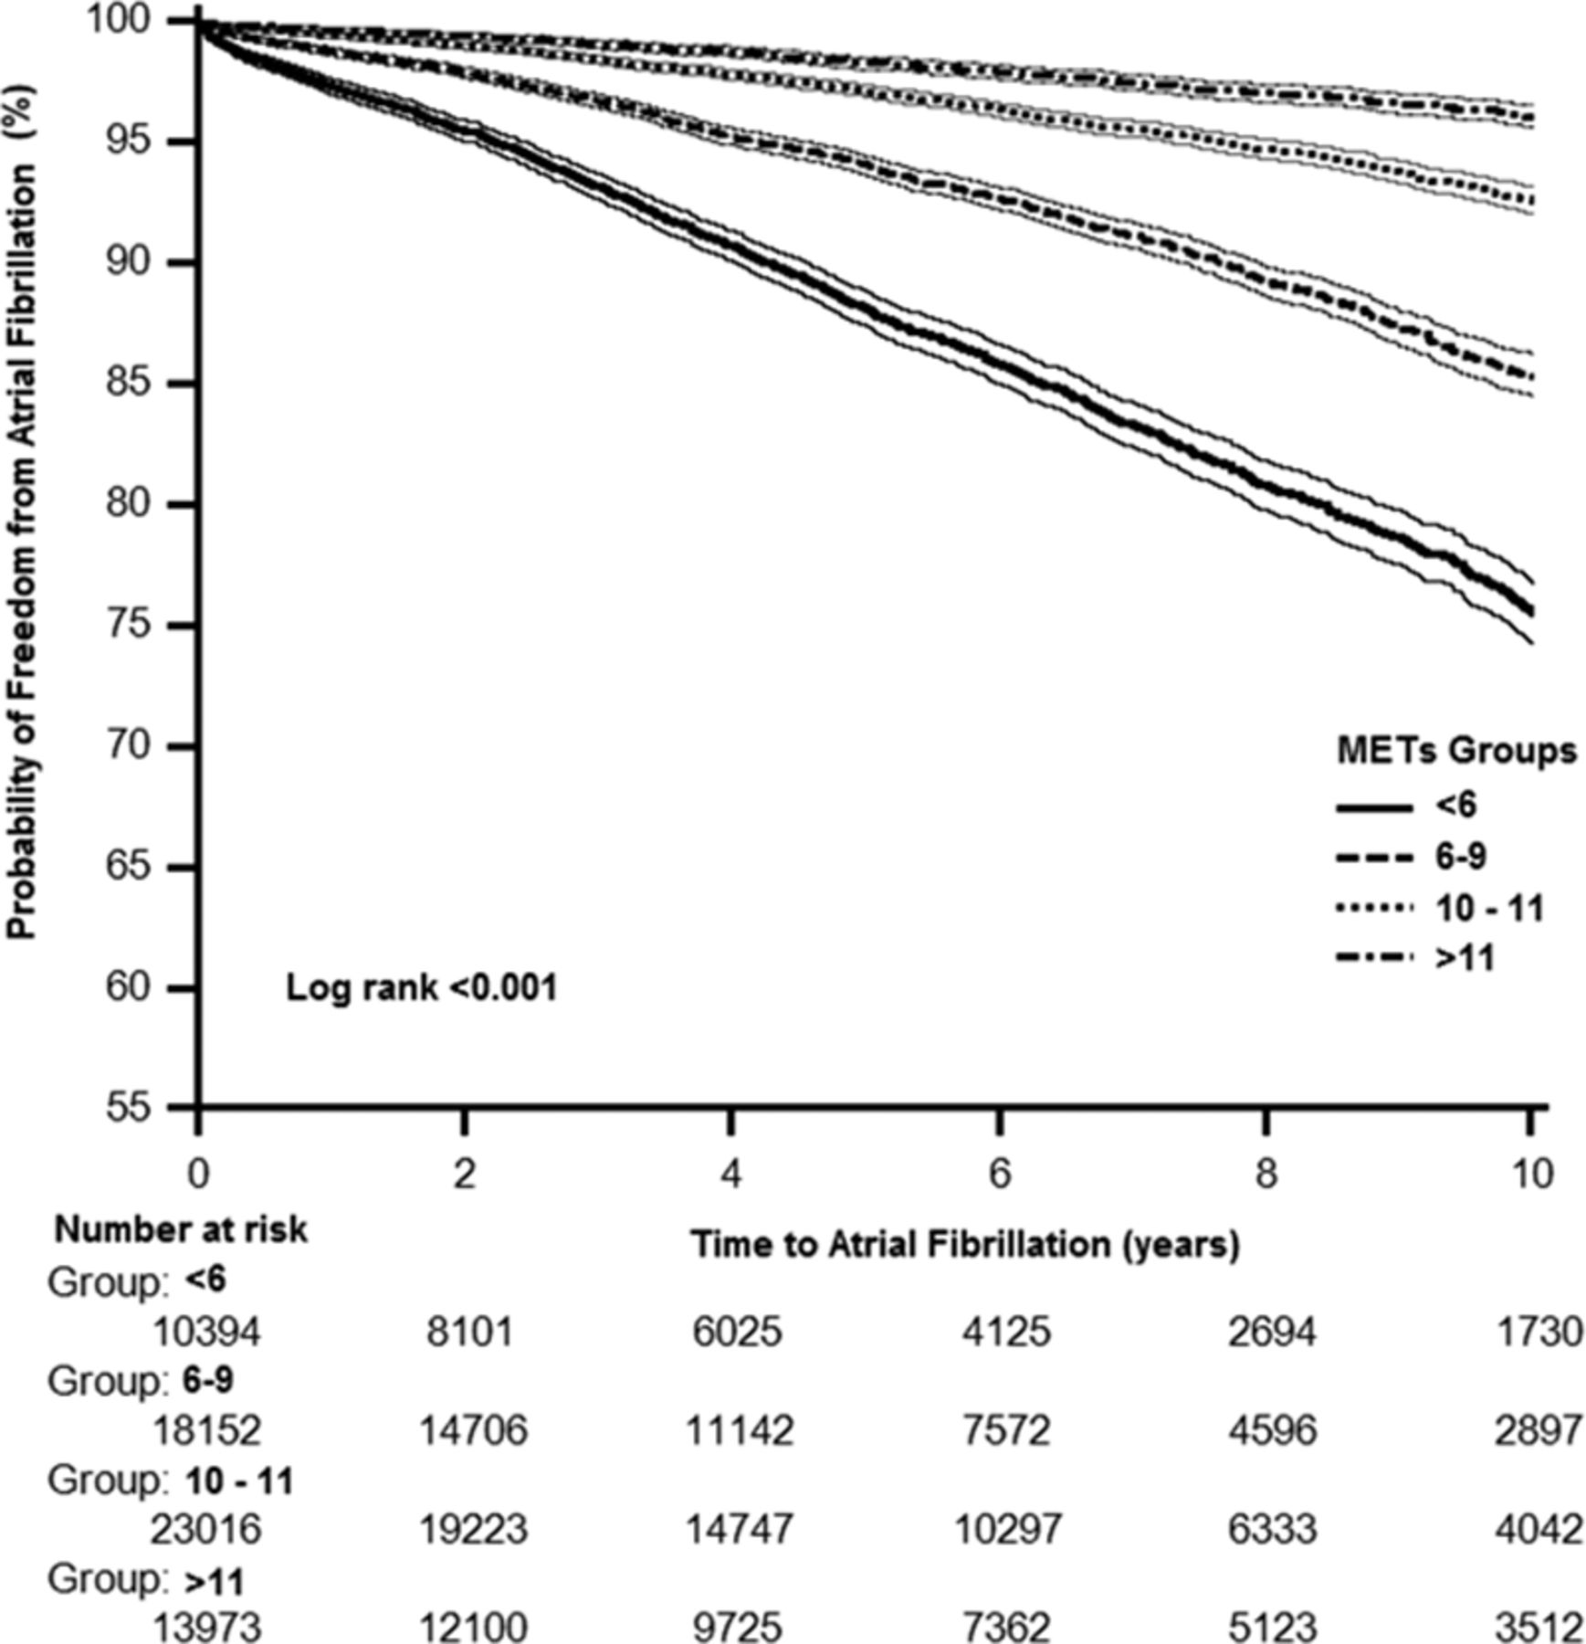

Time-to-event analysis of incident atrial fibrillation by category of metabolic equivalents (METs).
Conclusions—There is a graded, inverse relationship between cardiorespiratory fitness and incident AF, especially among obese patients.
Qureshi WT et al. Circulation. 2015;131:1827-1834
Copyright © American Heart Association, Inc. All rights reserved.
Notes:
Time-to-event analysis of incident atrial fibrillation by category of metabolic equivalents (METs). The P value was determined by a log-rank test.

Slide 10
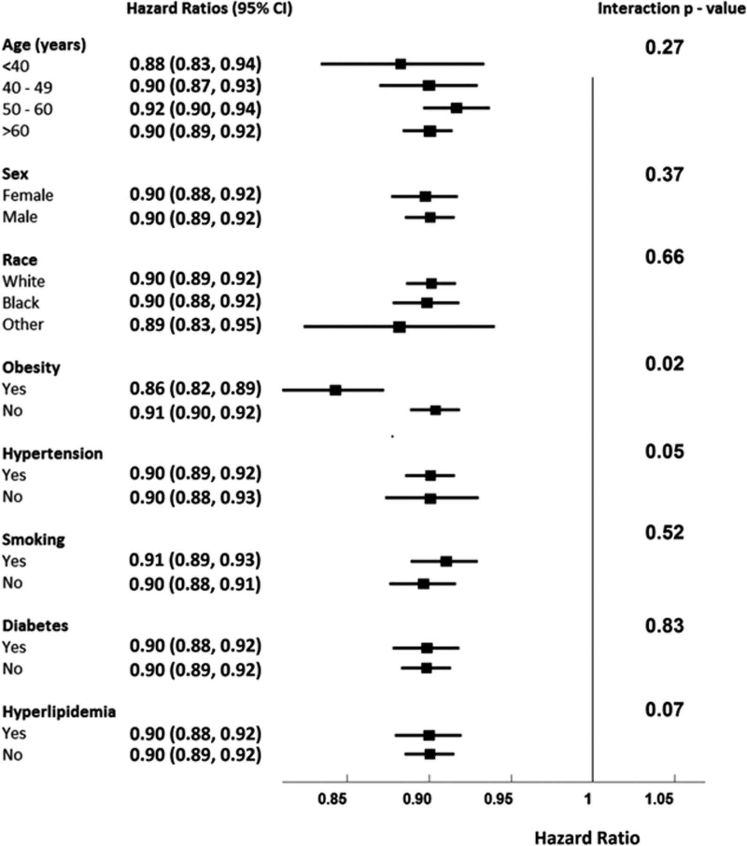
Risk of atrial fibrillation associated with baseline peak metabolic equivalents (METs; per 1 MET) within subgroups of the study cohort.
Waqas T. Qureshi et al. Circulation. 2015;131:1827-1834
Copyright © American Heart Association, Inc. All rights reserved.
Notes:
Risk of atrial fibrillation associated with baseline peak metabolic equivalents (METs; per 1 MET) within subgroups of the study cohort. CI indicates confidence interval. *All models were adjusted for age, sex, race, history of hypertension, diabetes mellitus, sedentary habits, obesity, family history of coronary artery disease, smoking, hyperlipidemia, hypertensive response, chronotropic incompetence, thyroid medications, digoxin, treated lung disease, β-blocker use, angiotensin-converting enzyme inhibitor use, angiotensin receptor blocker use, calcium channel blocker use, use of all lipid-lowering medications (including statins), and METs. In the age strata, the age variable was replaced with a simplified variable (<40, 40–49, 50–59, ≥60 years).

Slide 11
Incident AF in women & exercise?
Women enrolled in the Women’s Health Initiative (WHI) Study who achieved ≥7.5 MET·h/wk had ↓ risk of AF (HR, 0.86; 95% CI, 0.75–0.98; P=0.03). However, this association did not remain significant after adjustment for BMI (a measure of obesity).
These prospective data suggest modest amounts of regular physical activity is associated with a risk ↓ of AF in a population of middle-aged, initially healthy women.
In this population, the effects of physical activity on AF risk appear to be mediated by BMI but not by hypertension or cardiovascular disease.
No increased risk of AF among women reporting vigorous exercise, but few women engaged in high levels of vigorous exercise.
Everett BM et al. Circ cardiovasc Qual Outcomes 2011;4:321-327.

Slide 12
Cardiorespiratory Fitness (CRF) & Recurrent AF
Impact of CARDIOrespiratory FITness on Arrhythmia Recurrence in Obese Individuals With Atrial Fibrillation: The CARDIO-FIT Study.
Hypothesis: preserved CRF at baseline in obese AF patients offsets detrimental effects of obesity and gain in CRF through structured exercise program has synergistic effect with weight loss on freedom from AF.
  Single centre, observational study. N = 308
  Consecutive pts with symptomatic paroxysmal or permanent AF
  BMI ≥ 27 kg/m2
  Comprehensive wt. loss and exercise program
  F/U mean of 49 months
Pathak et al. JACC 2015;66(9):985-96
Notes:
Cardiorespiratory fitness predicts arrhythmia recurrence in obese individuals with symptomatic AF. Improvement in cardiorespiratory fitness augments the beneficial effects of weight loss.

Slide 13
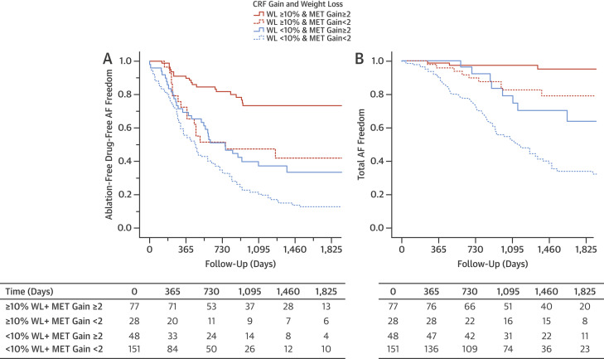
Outcomes of AF Freedom According to CRF Gain and WL:
(<2 METS gain vs > 2 METS Gain & <10% WL and >20% WL)
Pathak et al. JACC 2015;66(9):985-96
Notes:
Kaplan Meyer curves

Slide 14
CRF and Recurrent AF
Overweight and obese individuals with symptomatic AF, preserved baseline CRF predicts long-term freedom from AF.
Significant dose-response relationship between baseline CRF with 20% reduction in the risk of AF recurrence for each MET increase in baseline CRF.
CRF gain with a structured exercise has an additive effect to weight loss in improving the long-term outcome of AF.
METs gain in cardiorespiratory fitness ≥2 on top of weight loss were synergistic and associated with 2-fold greater freedom from AF.
Pathak et al. JACC 2015;66(9):985-96

Slide 15
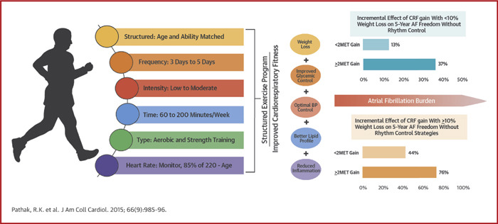
Cardio-Fit Study
Additional findings of improved
CV risk factors, LA and LV remodeling and ↓ CRP
↓

Slide 16
Exercise Training & Permanent AF
2 systematic reviews published 2013:
  lower heart rates during both exercise and moderate- to high-intensity activities of daily living
  ? through ↓ sympathetic and ↑ vagal modulation
Improves most common symptoms of chronic AF – poor exercise tolerance and dyspnea on exertion.
Potential method of treating and managing AF because of it’s association with:
  reversion to sinus rhythm
  increased success of cardioversion
  Decrease in beta-blocker requirements for rate control
Giacomantonio et al. Can J Cardiol .2013;29:483-491.
Reed JL et al. Can J Cardiol. 2013;29:1721-1728.
Notes:
Found to reduce sympathetic control of HR and increase parasympathetic activity to the heart, resulting in lower HR at rest and exercise.
Is believed that patients with AF experience greater control of HR through these sympathetic nervous branches.
In AF population, exercise training shown to improve 2 of the most common symptoms of AF – poor exercise tolerance and dyspnea on exertion.
Potential method of treating and managing AF because of it’s association with:
lowered heart rates during both exercise and moderate- to high-intensity activities of daily living,
reversion to sinus rhythm, and
increased success of cardioversion.

Slide 17
Exercise and Complications of AF?
Impact of Cardiorespiratory Fitness on Frequency of Atrial Fibrillation, Stroke, and All-Cause Mortality
Nasir Hussain et al. American Journal of Cardiology 2018;121(1):41-49

Slide 18
CRF & AF, CVA, mortality
Mayo clinic 1993-2010 for GXT - excluded AF, Aflutter, CVA, structural heart disease
Divided into 4 quartiles based on functional aerobic capacity (FAC)
FAC = achieved exercise time/sex and age predicted exercise time (%)
Followed until Jan 2016 for incident AF, CVA, mortality
N=12043 with median F/U 14 (9-17) yrs
1,222 AF, 1,128 CVA & 1,590 deaths
Hussain N et al Am J Cardiol. 2018;21(1):41-49

Slide 19
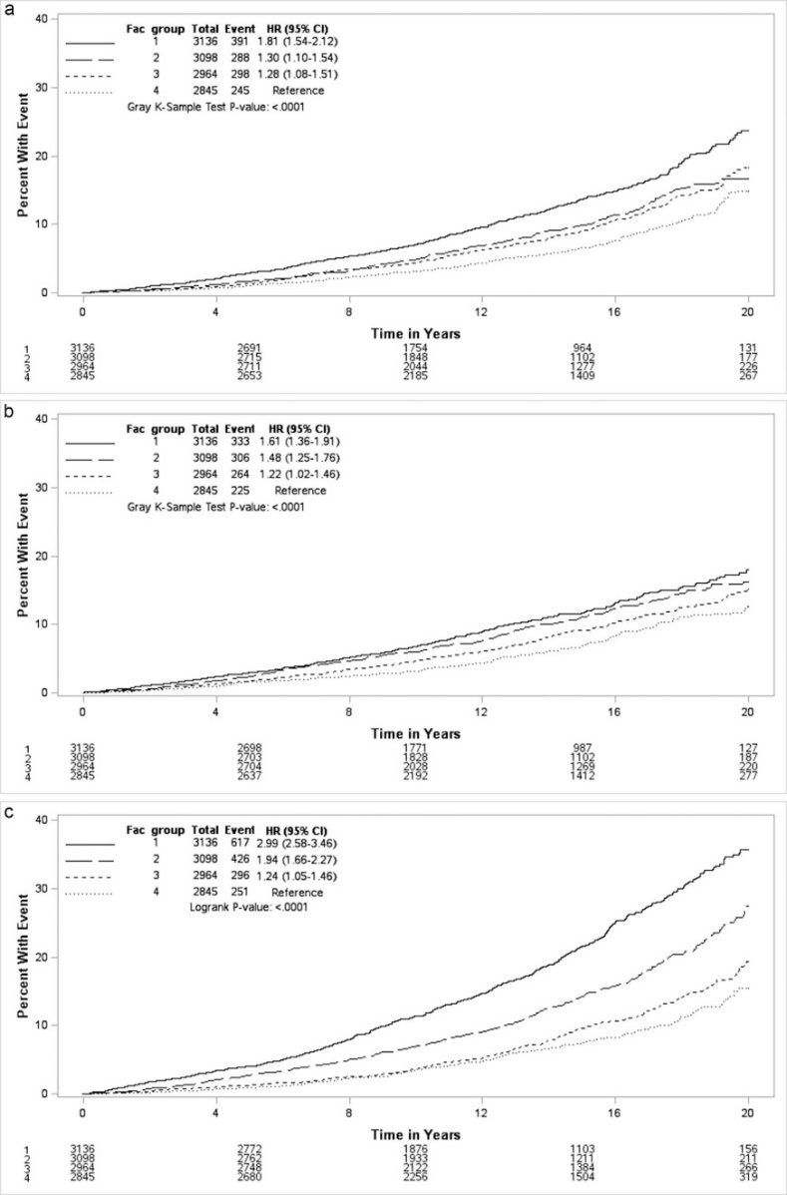

FAC quartiles:
<75%
75-89%
90-104%
≥105%
Plot A cumulative incidence of AF
Plot B cumulative incidence of stroke
Plot C cumulative mortality
American Journal of Cardiology 2018 121, 41-49DOI: (10.1016/j.amjcard.2017.09.021)
Copyright © 2017 Terms and Conditions
Notes:
(A) Cumulative incidence plot of atrial fibrillation by FAC groups with 95% confidence limits while considering mortality as a competing risk. Patients at risk of incident atrial fibrillation at a given time are shown below the plot. Group 1, < 75% FAC; Group 2, 75% to 89% FAC; Group 3, 90% to 104% FAC; and Group 4, ≥ 105% FAC. (B) Cumulative incidence plot of stroke by FAC groups with 95% confidence limits while considering mortality as a competing risk. Patients at risk of incident stroke at a given time are shown below the plot. Group 1, < 75% FAC; Group 2, 75% to 89% FAC; Group 3, 90% to 104% FAC; and Group 4, ≥ 105% FAC. (C) Cumulative incidence plot of mortality by FAC groups with 95% confidence limits. Patients at risk of mortality at a given time are shown below the plot. Group 1, < 75% FAC; Group 2, 75% to 89% FAC; Group 3, 90% to 104% FAC; and Group 4, ≥ 105% FAC.

Slide 20
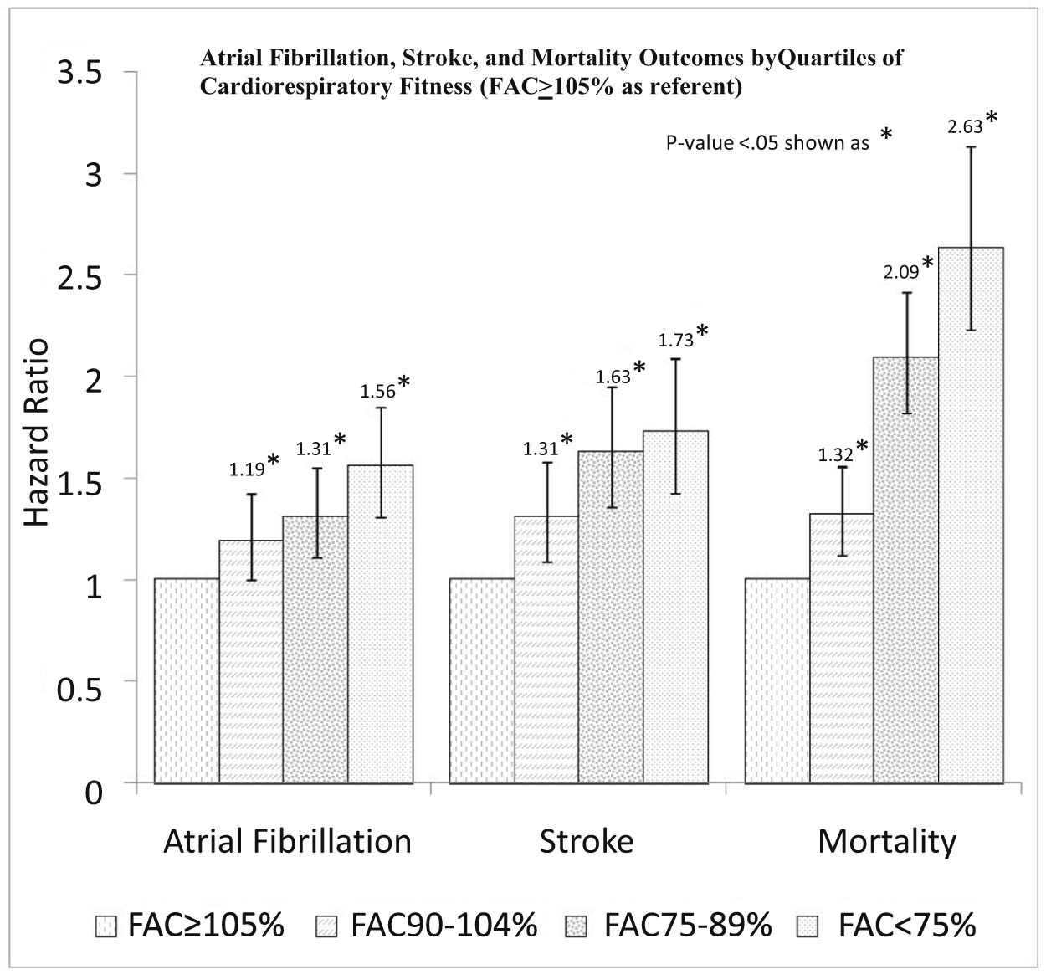
Hazard ratio for incident AF, CVA and Mortality with patients with FAC of ≥ 105% as referent
FAC = functional activity capacity
American Journal of Cardiology 2018 121, 41-49DOI: (10.1016/j.amjcard.2017.09.021)
Copyright © 2017 Terms and Conditions
Notes:
Incident atrial fibrillation, stroke, and all-cause mortality outcomes by FAC groups; patients with FAC ≥105% were used as referent, hazard ratio with confidence intervals for each FAC group are shown. Atrial fibrillation outcome was adjusted for significant Model 3 variables: age, sex, hypertension, chronic obstructive pulmonary disease, current smokers, past smokers, sleep apnea, coronary artery disease, β-blocker, aspirin, and anticoagulant use, and BMI (kg/m²) as a continuous variable. FAC was replaced with categorical variables, Group 1, < 75% FAC; Group 2, 75% to 89% FAC; Group 3, 90% to 104% FAC; and Group 4, ≥ 105% FAC. Group 4 was used as referent. Stroke and mortality outcome were adjusted for all of Model 5 variables: age, sex, hypertension, chronic obstructive pulmonary disease, current smokers, past smokers, sleep apnea, coronary artery disease, indication for test, diabetes, hyperlipidemia, chronic kidney disease, and use of β-blockers, angiotensin-converting enzyme inhibitors, angiotensin II receptor blockers, calcium-channel blockers, alpha adrenergic blockers, long-acting nitrates, statins, levothyroxine, aspirin, antiplatelet, anticoagulants, and bronchodilators. BMI (kg/m²) as a continuous variable was added to this model. FAC was replaced with categorical variables, Group 1, < 75% FAC; Group 2, 75% to 89% FAC; Group 3, 90% to 104% FAC; and Group 4, ≥ 105% FAC. Group 4 was used as referent.

Slide 21
CRF and AF, CVA, Mortality
Each 10% ↑in functional aerobic capacity (FAC) associated with ↓risk of incident AF, stroke and mortality by 7%, 8% and 16% respectively.
In patients who developed incident AF with baseline FAC <75% versus ≥105%, risks of both stroke (1.40 [1.04 to 1.90, p = 0.01]) and mortality (3.20 [2.11 to 4.58, p < 0.001]) were significantly increased.
In conclusion
Better cardiorespiratory fitness is associated with lower risk of incident AF, stroke, and mortality.
Similarly, risk of stroke and mortality in patients with AF is also inversely associated with cardiorespiratory fitness.
Hussain N et al Am J Cardiol. 2018;21(1):41-49
Notes:
Each 10% increase in FAC was associated with decreased risk of incident AF, stroke, and mortality by 7% (0.93 [0.91 to 0.96, p < 0.001]), 8% (0.92 [0.89 to 0.94, p < 0.001]), and 16% (0.84 [0.82 to 0.86, p < 0.001]), respectively. In patients who developed incident AF with baseline FAC <75% versus ≥105%, risks of both stroke (1.40 [1.04 to 1.90, p = 0.01]) and mortality (3.20 [2.11 to 4.58, p < 0.001]) were significantly higher. In conclusion, better cardiorespiratory fitness is associated with lower risk of incident AF, stroke, and mortality. Similarly, risk of stroke and mortality in patients with AF is also inversely associated with cardiorespiratory fitness.In conclusion, better cardiorespiratory fitness is associated with lower risk of incident AF, stroke, and mortality. Similarly, risk of stroke and mortality in patients with AF is also inversely associated with cardiorespiratory fitness.

Slide 22
What Type of Exercise is Best?
Moderate Intensity Continuous (aerobic) Exercise (MICE)
vs.
High Intensity Interval Training (HIIT)?

Slide 23
HIIT vs. MICE
Short, intense, non-oxidative exercise with less intense recovery periods
Brief, effective and efficient training sessions
?more motivating, lower dropout rates?
?superior increases in VO2 peak through both central and peripheral mechanisms?
In heart failure, HITT leads to greater ↓HR in patients in SR - ?superior modulation of vagal tone?
Burgomaster KA et al. J Physiol 2008;586:151-160.
Guiraud T et al. Med Sci Sports Exerc 2013;45:1861-1867.

Slide 24
Aerobic Interval Training Reduces the Burden of Atrial Fibrillation in the Short TermCLINICAL PERSPECTIVE
by Vegard Malmo, Bjarne M. Nes, Brage H. Amundsen, Arnt-Erik Tjonna, Asbjorn Stoylen, Ole Rossvoll, Ulrik Wisloff, and Jan P. Loennechen
51 pts , non-permanent AF
N= 26 HIIT with 4X4 mins 85-95% peak HR 3X week for 12 weeks
N= 25 controls
AF burden - implanted loop from 4 weeks before to 4 weeks post intervention
Circulation
Volume 133(5):466-473
February 2, 2016
Copyright © American Heart Association, Inc. All rights reserved.

Slide 25
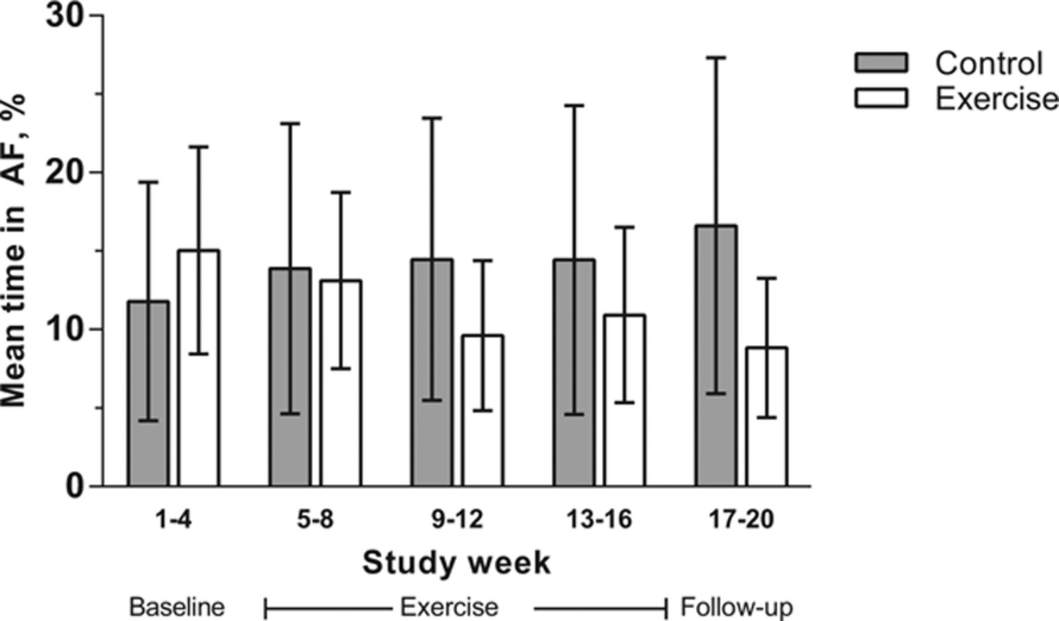
Atrial fibrillation (AF) burden in patients with AF during the study.
HIIT reduced AF burden by 6.2 %
vs
controls increased 4.8%
11.0% between groups P=0.0007
Also improved QoL, symptoms, VO2 peak and LA and LV function
Vegard Malmo et al. Circulation. 2016;133:466-473
Copyright © American Heart Association, Inc. All rights reserved.
Notes:
Atrial fibrillation (AF) burden in patients with AF during the study. Mean time in AF was measured by an implanted loop recorder (n=36) before, during, and after 12 weeks of aerobic interval training (exercise) or usual care (control). Patients without AF during the study period are excluded. Mean changes from baseline to follow up were −6.2±8.9 percentage points (pp), P=0.02 for exercise; 4.8±12.5 pp, P=0.09 for control; and 11.0±3.9 pp, P=0.007 between groups. Error bars show the 95% confidence interval.

Slide 26
Is there a “toxic range” for exercise & AF?

Slide 27

Extreme Endurance Exercise

Slide 28
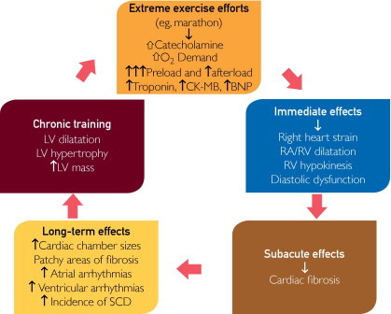
Proposed pathogenesis of cardiomyopathy in endurance athletes
FIGURE 7
O’Keefe JH et al. Mayo Clin Proc 2012;87(6):587-595.

Slide 29
Excessive Endurance and Arrhythmia
Elite endurance athletes - ECG abnormalities, PACs and PVCs
Patchy myocardial fibrosis in atria, IVS and RV and RV overload– substrate for more significant atrial and ventricular arrhythmias
5-fold ↑ in AF – potential mechanisms
  Impairment in sympathovagal tone
  Inflammation
  Atrial remodeling and fibrosis
However these are the extremes and none of the studies reported today or undertaken for the purpose of AF and exercise evaluation have shown the U shaped curve for benefit vs hazard – these are not elite athletes!
O’Keefe JH et al. Mayo Clin Proc 2012:87(6):587-595.

Slide 30
AF & Cardiac Rehabilitation?
Exercise based cardiac rehabilitation for adults with atrial fibrillation
Risom SS, Zwister A, Johansen et al.
Cochrane Database Syst Rev Published on line 9th Feb 2017
Due to few randomised patients and outcomes - could not evaluate the real impact of exercise-based cardiac rehabilitation on mortality or serious adverse events.
Pooled data showed a positive effect on the surrogate outcome of physical exercise capacity, but due to the low number of patients and the moderate to very low-quality of the underpinning evidence, we could not be certain of the magnitude of the effect.
Future high-quality randomised trials are needed to assess the benefits and harms of exercise-based cardiac rehabilitation for adults with atrial fibrillation on patient-relevant outcomes.

Slide 31
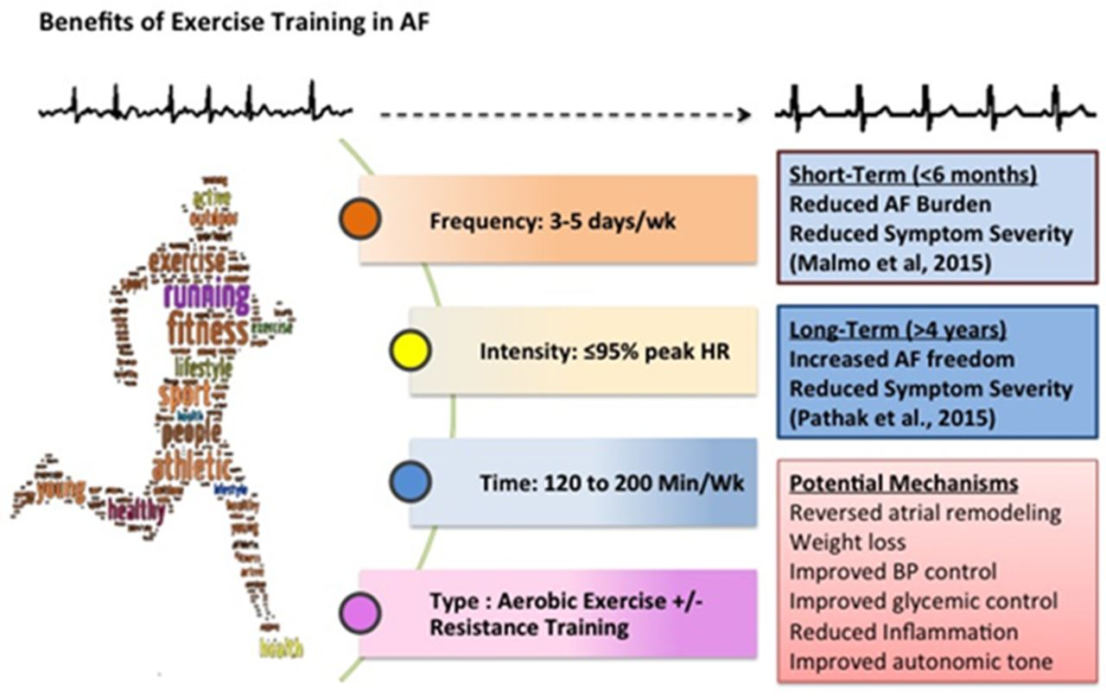
Overview of existing knowledge regarding exercise training and atrial fibrillation.
Adrian D. Elliott et al. Circulation. 2016;133:457-459
Copyright © American Heart Association, Inc. All rights reserved.
Notes:
Overview of existing knowledge regarding exercise training and atrial fibrillation. AF indicates atrial fibrillation; BP, blood pressure; and HR, heart rate.
From Editorial to Malmo HIIT study

Slide 32
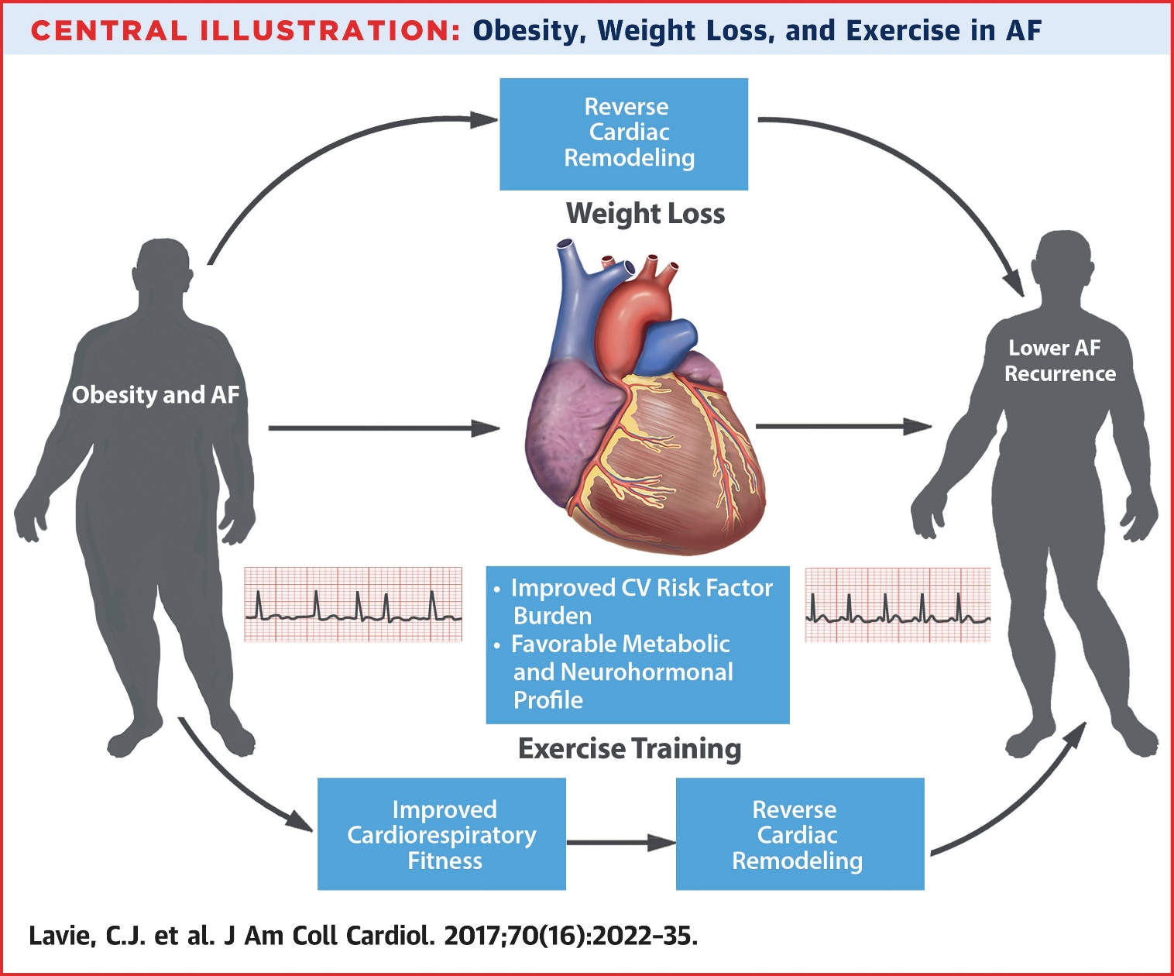
Exercise As Lifestyle intervention and a 4th pillar in management of AF
Baseline CRF
-Lower incident AF
-Lower recurrence AF
-lower complications of CVA and mortality

Slide 33
Exercise as Medicine in AF
Promising 4th pillar in the management of AF

Slide 34
Questions?

